Slide 1

Advanced Python
Data Visualisation

Slide 2
Module 3B: Data Visualisation ~ Seaborn ~

Slide 3
Module Objectives After completing this module you will be able to
Explain the relationship between Matplotlib and Seaborn, and when to use each
Create distribution plots
Create categorical plots
Create relational plots
Create joint plots
Customise pots by changing plot style and colours

Slide 4


Seaborn
4

Slide 5
Seaborn: introduction
Seaborn is a Python data visualization library based on Matplotlib.
It provides a high-level interface for drawing attractive and informative statistical graphics.
To start, we need to import the seaborn library
By convention, the alias ‘sns’ is used while importing the Seaborn library
>>> import seaborn as sns
Behind the scenes, seaborn uses matplotlib to draw its plots.
It is therefore common practice to import the matplotlib library together with seaborn >>> import matplotlib.pyplot as plt
>>> import seaborn as sns
To see the plot use plt.show(), or to save it into a file use plt.savefig(), as usual
Notes:
Note: Seaborn does not come with Python. You need to download and install it separately.
Trivia: the meaning of ‘sns’: initials of Samuel Norman Seaborn, a fictional character on the television serial drama ”The West Wing”. Basically, an inside joke related to the origin of the name "Seaborn“ by its creator, Michael Waskom. Nothing serious.

Slide 6
Seaborn vs Matplotlib
Seaborn is a visualization library in Python, built on top of Matplotlib
Seaborn compliments and extends Matplotlib (it is not meant to be Matplotlib’s replacement); if you know Matplotlib, you are already half-way through Seaborn
In most cases, you will still use Matplotlib for simple plotting
The knowledge of Matplotlib is recommended to tweak Seaborn’s default plots
Seaborn helps resolve the two major problems faced by Matplotlib; the problems are:
Default Matplotlib parameters
Working with data frames
Official Seaborn documentation: https://seaborn.pydata.org/
Notes:
First problem: Default Matplotlib parameters:
In Matplotlib relatively poor default options for the size and colours of plots are offered.
Matplotlib is often considered to be a low-level technology compared to today’s requirements.
Thus, very specialized code is needed to generate appealing plots.
Second problem: Working with data frames:
Matplotlib is very much associated with Pandas and NumPy and goes about as a graphics package for Python data visualisation.
Seaborn is more suited for taking care of data frames in Pandas. Seaborn plotting functions operate on DataFrames and arrays that contain a whole dataset.
With Seaborn, you can either use one of the built-in data sets that the library itself has to offer or you can load a Pandas DataFrame. The list of built-in data sets can be found here: https://github.com/mwaskom/seaborn-data
A data frame is a table or a two-dimensional array-like structure in which each column contains values of one variable and each row contains one set of values from each column.
Specifically for Python, DataFrames come with the Pandas library, and they are defined as a two-dimensional labelled data structures with columns of potentially different types.

Slide 7
Seaborn – Dependencies and Uses
The following are dependencies of Seaborn
Python 2.7 or 3.4+
NumPy (for performing mathematical computations on large multi-dimensional arrays)
SciPy (for scientific computing: optimisation, linear algebra, interpolation, image processing etc.)
Pandas (for managing datasets)
Matplotlib (to generate simple plots and for additional customisation)
Seaborn is used for plotting and styling of more complex plots
We are going to explore the following uses of Seaborn:
visualising data distribution (creating distribution plots)
visualising categorical data (creating categorical plots)
visualising relational data (creating relational plots)
creating joint plots
changing plot style and colours
Notes:
Note: Python 2.7 is the last major release in the 2.x series, before Python maintainers have shifted the focus of their new feature development efforts to the Python 3.x series.
SciPy is pronounced /ˈsaɪpaɪ'/ "Sigh Pie"

Slide 8
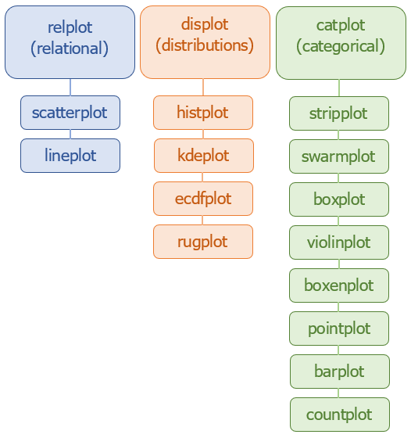
Seaborn – Plotting Functions Hierarchy
relplot() is used for plotting relational plots
displot() is used for plotting distributional variables
catplot() is used for plotting categorical variables
Notes:
Seaborn classifies its functions as “axes-level” and “figure-level”.
The major difference between axes-level and figure-level functions is that axes-level functions create a single plot, while figure-level functions can in addition to single plots, produce multi-plots, to segregate data attributes into rows and columns of subplots.
Axes-level functions return the Axes object (ax : matplotlib Axes) with the plot drawn onto it. They plot data onto a single matplotlib.pyplot.Axes object, which is the return value of the function.
Figure-level functions return a FacetGrid object object with the plot on it. Figure-level functions interface with matplotlib through a seaborn object: FacetGrid, that manages the figure. FacetGrid is a seaborn class whose objects have the capability to produce a multi-plot grid for plotting conditional relationships, where each subplot illustrates a different condition. This means that you can easily create subplots using its object (multiple axes aligned in a grid of rows and columns that outputs subplots).
The three most common plots in relation to what they visualise are:
Relational plots - show the relationship between multiple variables in a dataset
Distribution plots - show the distribution of variables in a dataset
Categorical plots - show the relationship between a numerical variable and one or more categorical variables in a dataset
The Seaborn functions at the top level: relplot, displot and catplot, are all figure-level functions. They return a FacetGrid object with the plot on it.
relplot() is a figure-level interface for drawing relational plots onto a FacetGrid.
displot() is a figure-level interface for drawing distribution plots onto a FacetGrid. catplot() is a figure-level interface for drawing categorical plots onto a FacetGrid.
Each of these three figure-level functions offers a unitary interface to its various axes-level functions.
The functions below these three functions are axes-level functions.
Each of the three top-level functions allow creating the plots listed below them, through the kind key word argument (kwarg). The parameter kind determines the kind of plot to draw, corresponding to the name of a axes-level plotting function.
For relplot(), kind options are: “scatter” or “line”.
For displot(), kind options are: “hist”, “kde” or “ecdf”. Additionally, a rugplot() can be added to any kind of these plots to show individual observations.
For catplot(), kind options are: “strip”, “swarm”, “box”, “violin”, “boxen”, “point”, “bar”, or “count”.
In addition to the kind kwarg, each of these underlying functions exist on their own, with additional arguments:
for relplot(), there are 2 separate functions: scatterplot() and lineplot(), offering 2 different types of relational plots.
for displot(), there are 3 separate functions: histplot(), kdeplot() and ecdfplot(), offering 3 different types of distribution plots, as well as the before-mentioned additional rugplot() function.
for catplot(), there are 8 separate functions: stripplot(), swarmplot(), boxplot(), violinplot(), boxenplot(), pointplot(), barplot() and countplot(), offering 8 different types of categorical plots.
Source:
https://seaborn.pydata.org/tutorial/function_overview.html

Slide 9
Seaborn – Data Distribution
What is it?
Data Distribution is a list of all possible values, with their frequencies (how often each value occurs) or probabilities (the likelihood of each value occurring).
What’s the use of it?
Such lists are important when working with statistics and data science.
In order to make a simulation model realistic, it is necessary to produce values that conform with most common cases in reality

Slide 10
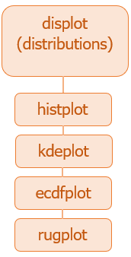
Seaborn – Data Distribution
dispot() is a figure-level function for visualizing distributions of a variable.
Through the kind keyword argument, displot() combines a FacetGrid with one of the three axes-level functions:
histplot() (with kind=“hist"; the default)
kdeplot() (with kind=“kde")
ecdfplot() (with kind=“ecdf")
The additional rugplot() function is intended to complement other plots by showing the location of individual observations in an unobtrusive way: it can be used to add ticks (‘rugs’) on the side of any other kind of plot
Notes:
Official Seaborn documentation on distributional plots:
https://seaborn.pydata.org/tutorial/distributions.html

Slide 11
Seaborn – Data Distribution
For example, to simulate the exam scores for a group of students, where score is within the interval [0, 10], past history shows that:
the scores are not going to be uniformly distributed between 0 and 10
the average score is around 7
The basic randint(0, 10) function from the random module, generates a random integer between 0 and 10
In this situation, within the distribution, very high and very low values are still possible, but are less frequent than the ones closer to the average
To generate random numbers based on defined probabilities use the choice() method of NumPy’s random module.

Slide 12
Seaborn – Random Data Distribution
The choice() method allows us to specify the probability for each value.
The probability is set by a number between 0 and 1, where 0 means that the value will never occur and 1 means that the value will always occur.
The sum of all probability numbers should be 1.
Example: Generate a 1-D array containing 100 scores, where the score probability is given in the table on the right
from numpy import random
scores = random.choice([0, 1, 2, 3, 4, 5, 6, 7, 8, 9, 10], size=100,
p=[0.01, 0.02, 0.03, 0.04, 0.05,
0.12, 0.15, 0.25, 0.13, 0.12, 0.08])
print(scores)
Score | Probability
0 | 0.01
1 | 0.02
2 | 0.03
3 | 0.04
4 | 0.05
5 | 0.12
6 | 0.15
7 | 0.25
8 | 0.13
9 | 0.12
10 | 0.08
Notes:
The official documentation on the choice() NumPy method:
https://numpy.org/doc/stable/reference/random/generated/numpy.random.choice.html

Slide 13
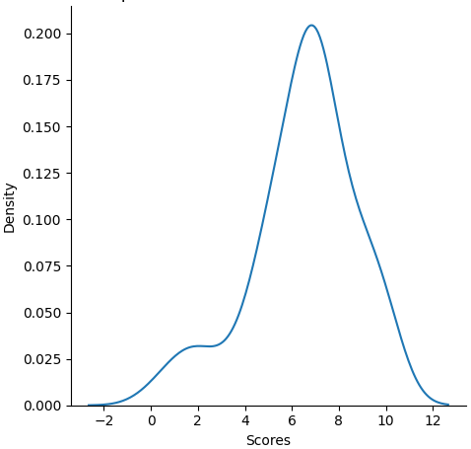
Seaborn – Kernel Density Estimate Plot
The choice() method from previous script returns a 1-D array of 100 randomly chosen numbers within 0 and 10, following the probability for each number as given in the table
To visualise this distribution use the displot() function:
sns.displot(data=scores, kind='kde')
plt.savefig('distribution_plot.py')
Use Pandas objects to get an informative axis label:
import pandas as pd
scores_series = pd.Series(scores, name='Scores')
sns.displot(data=scores_series, kind='kde')
The final plot shown is shown on the right
Another way of creating the kde plot:
sns.kdeplot(data=scores_series)
Notes:
Note: There is an older function: distplot(), that can be used to achieve the same:
sns.distplot(x, hist=False)
However, ‘distplot’ is a deprecated function and will be removed in a future version. A warning message will appear saying: “Please adapt your code to use either ‘displot’ (a figure-level function with similar flexibility) or ‘kdeplot’ (an axes-level function for kernel density plots)”
A kernel density estimate (KDE) plot is a method for visualizing the distribution of observations in a dataset, analogous to a histogram. KDE represents the data using a continuous probability density curve in one or more dimensions. Essentially, instead of a histogram (a column chart), the data are visualised through a curve. Change the attribute to kind=‘hist’ to see the data represented through a histogram.
The official documentation for displot() function:
https://seaborn.pydata.org/generated/seaborn.displot.html

Slide 14
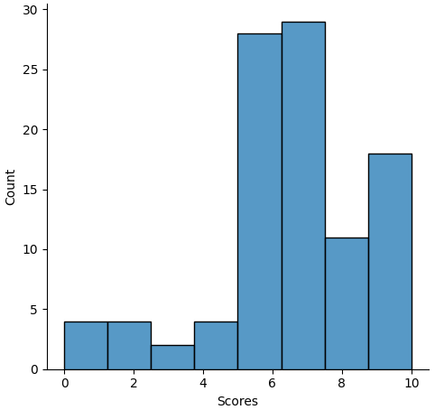
Seaborn – Histogram
A histogram is a bar plot where the axis representing the data variable is divided into a set of discrete bins and the count of observations falling within each bin is shown using the height of the corresponding bar
Histogram is the most common approach to visualizing a distribution: kind='hist' is the default approach for data visualisation in displot() function
To display the histogram for the previous example, use one of the following three ways:
sns.displot(data=scores_series, kind='hist')
sns.displot(data=scores_series)
sns.histplot(data=scores_series)
The image on the right shows the outcome
Notes:
The official documentation for histplot() function:
https://seaborn.pydata.org/generated/seaborn.histplot.html#seaborn.histplot

Slide 15
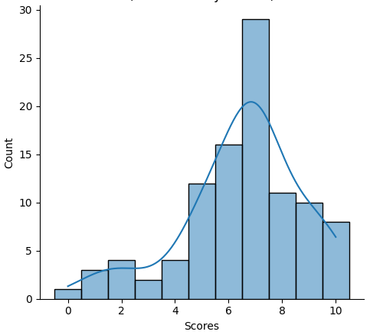
Seaborn – KDE & Histogram together
To display both kde and histogram, set the kde key word argument to True:
sns.displot(data=scores_series, kde=True, discrete=True)
kind='hist‘ by default.
kde=True includes the kde plot
discrete=True centres bars on their corresponding value on x-axis
Note: Always set the discrete key word argument to True when displaying histograms, otherwise numbers corresponding to the bars on the x-axis won’t be displayed in the centre of the bars
discrete=True kwarg can be used with both displot() and histplot() functions
Notes:
Note: Look at the diagram from the previous slide, where the discrete key word argument is not set to True – the numbers corresponding to the bars on the x-axis are not displayed in the centre of the bars.

Slide 16
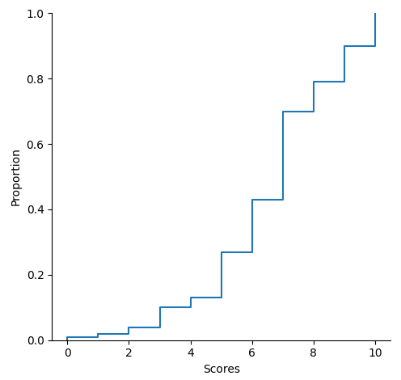
Seaborn – ECDF plot
In Empirical Cumulative Distribution Functions (ECDF) plot, the x-axis corresponds to the range of values for the variable whereas the y-axis corresponds to the proportion of data points that are less than or equal to the corresponding value of the x-axis.
To display (ecdf) either use the displot() figure-level function with kind='ecdf':
sns.displot(data=scores_series, kind='ecdf')
or use the ecdfplot() axes-level function:
sns.ecdfplot(data=scores_series)
Notes:
The official documentation for histplot() function:
https://seaborn.pydata.org/generated/seaborn.ecdfplot.html#seaborn.ecdfplot

Slide 17
Seaborn – Categorical Data
In general, variables can be classified as
Quantitative (numerical)
Qualitative (categorical)
Quantitative variables represent a measurable quantity, such as distance, weight or population of a country. They can be quantified into numerical values.
In statistics, a categorical variable (aka qualitative variable) is a variable that has values that can be put into a countable number of distinct groups (categories) based on a characteristic.
As opposed to quantitative variables, values of categorical variables are often not numerical, such as gender, age range, nationality or type of an animal.

Slide 18
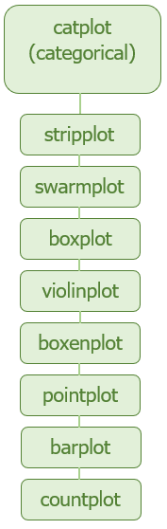
Seaborn – Categorical Plots
catpot() is a figure-level function for visualizing statistical relationships involving a categorical variable.
Through the kind keyword argument, catplot() combines a FacetGrid with one of the eight axes-level functions:
striplot() (with kind="strip"; the default)
swarmplot() (with kind=“swarm")
boxplot() (with kind=“box")
violinplot() (with kind=“violin")
boxenplot() (with kind=“boxen")
pointplot() (with kind=“point")
barplot() (with kind=“bar")
countplot() (with kind=“count")
Notes:
Official Seaborn documentation on categorical plots:
https://seaborn.pydata.org/tutorial/categorical.html

Slide 19
Seaborn – Categorical Plots: swarmplot()
With Seaborn, you can either use one of the built-in data sets that the library itself has to offer or you can load a Pandas DataFrame.
The list of built-in seaborn data sets can be found here:
https://github.com/mwaskom/seaborn-data
import matplotlib.pyplot as plt
import seaborn as sns
# load the built-in 'iris' data set into a data frame
df_iris = sns.load_dataset("iris")
# construct the iris plot sns.swarmplot(data=df_iris , x='species', y='petal_length')
# save the plot into a file
plt.savefig('swarmplot.png')
Notes:
The official documentation for load_dataset() function:
http://seaborn.pydata.org/generated/seaborn.load_dataset.html
The list of all built-in Seaborn data sets can be obtained through the get_dataset_names() Seaborn function:
>>> sns.get_dataset_names()
['anagrams', 'anscombe', 'attention', 'brain_networks', 'car_crashes', 'diamonds', 'dots', 'exercise', 'flights', 'fmri', 'gammas', 'geyser', 'iris', 'mpg', 'penguins', 'planets', 'taxis', 'tips', 'titanic’]
To print all the column headers of a data frame (e.g. df_iris):
>>> df_iris.columns
Index(['sepal_length', 'sepal_width', 'petal_length', 'petal_width', 'species'], dtype='object')
# OR
>>>print(df_iris.columns.values)
['sepal_length' 'sepal_width' 'petal_length' 'petal_width' 'species’]
# OR
>>> print(df_iris.columns.tolist())
['sepal_length’, 'sepal_width', 'petal_length', 'petal_width', 'species’]

Slide 20
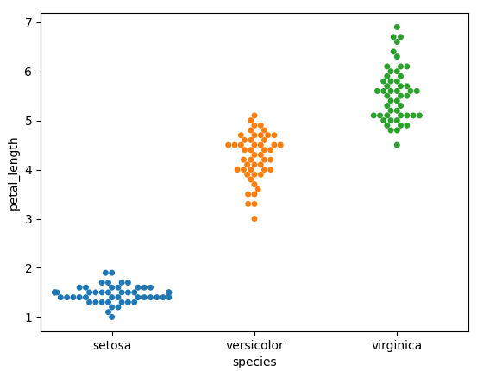
Seaborn – Working with built-in data sets
The resulting plot is shown below
With Seaborn, the labels from data frames are automatically propagated to plots or other data structures
Here, the x-axis label “species” and the y-axis label “petal_length” are (column) labels of the iris built-in data set
Note that this is not the case with the Matplotlib plots
Notes:
Note: setosa, versicolor and virginica are three species of iris flower

Slide 21
Seaborn – Working with built-in data sets
The plot from previous slide was produced using the axes-level function swarmplot()
The same plot can be produced using the figure-level function catplot():
sns.catplot(data=df_iris, x='species', y='petal_length', kind='swarm',
height=4, aspect=2)
The kind keyword argument is used to state the kind of plot to draw, corresponding to the name of a categorical axes-level plotting function – in this case ‘swarm’
The last two keyword arguments: height and aspect, are used to change the size (height and width, where width = hight * aspect) of each subplot (‘facet’), so that all points fit into the plot – in this case facet represents the single plot showing the three species of iris flower: setosa, versicolor and virginica
Facet plots, also known as trellis plots or small multiples, are figures made up of multiple subplots which have the same set of axes, where each subplot shows a subset of the data.
Notes:
Note: The two keyword arguments: height and aspect correspond to the size of each subplot, rather than the size of the overall figure.​ Setting height=4, width=2 makes the width 2 times larger than height (8).
​
To change the size of an axes-level plot, use the Seaborn set method, for example:
sns.set(style=None, rc={"figure.figsize":(10, 7)})
(style=None removes the darkgrid, as style='darkgrid' by default; width=10, height=7)
https://www.statology.org/seaborn-figure-size/
The official documentation for catplot() function:
https://seaborn.pydata.org/generated/seaborn.catplot.html

Slide 22
Seaborn – Categorical Plots: countplot()
A count plot can be thought of as a histogram across a categorical (column/bar plot), instead of quantitative, variable
Seaborn countplot() function creates bar charts of the number of observations per category
This function always treats one of the variables as categorical and draws data at ordinal positions (0, 1, … n) on the relevant axis, even when the data has a numeric or date type.
In most cases, it is possible to use numpy or Python objects, but pandas objects are preferable because the associated names will be used to annotate the axes.
Additionally, you can use Categorical types for the grouping variables to control the order of plot elements.
countplot() function can be used to show value counts for one or two categorical variables
Notes:
The official documentation for countplot() function:
http://seaborn.pydata.org/generated/seaborn.countplot.html#seaborn.countplot

Slide 23
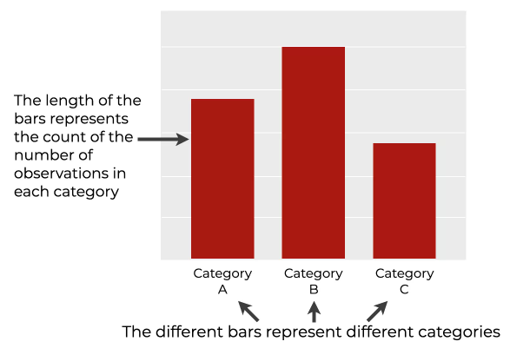
Seaborn – Categorical Plots: countplot()
countplot() axes-level function literally counts the number of observations per category for a categorical variable, and displays the results as a bar chart.
Basic Syntax:
sns.countplot(data=, x=, y=, hue=, color=)
data – maps to the dataset containing data to be used for plotting. Each column should correspond to a variable, and each row should correspond to an observation
x – maps a categorical variable to the x-axis (creates vertical bars)
y – maps a categorical variable to the y-axis (creates horizontal bars)
hue – maps a second categorical variable to the “hue” of the bars, creating a new set of bars for each category (value) of the second categorical variable
color – sets the colour of each bar to the same (specified) colour
Notes:
Note: Setting values for both the x and y parameters in the same countplot() function call throws an error. Only one of them can be used (x to plot vertical bars; y to plot horizontal bars).
You can use the hue parameter to map a second categorical variable to the “hue” of the bars.
In this case, the colours of different bars will correspond to the categories of the second categorical variable.
This enables you to create so-called “dodged” bar charts.

Slide 24
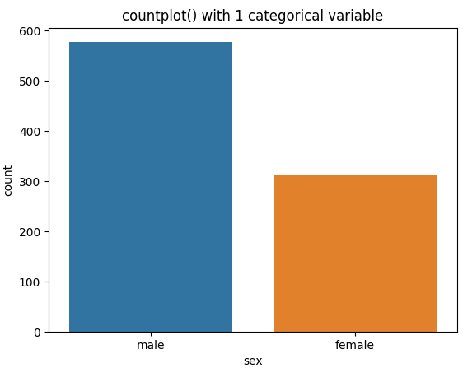
Seaborn – Categorical Plots: countplot()
# import necessary libraries
import matplotlib.pyplot as plt
import seaborn as sns
# load the built-in 'titanic' data set into a data frame
df_titanic = sns.load_dataset("titanic")
# draw the plot and include the plot title
sns.countplot(data=df_titanic, x="sex")
plt.title("Total number of passengers by gender")
plt.show()
countplot() applied to a single categorical variable
Example: Show the number of passengers by gender (categorical variable 'sex’)
Notes:
# the same plot can be drawn using catplot() function:
sns.catplot(data=df_titanic, x='sex', kind='count')
plt.title("Total number of passengers by gender")
plt.tight_layout()
plt.show()
The official documentation for countplot() function:
http://seaborn.pydata.org/generated/seaborn.countplot.html

Slide 25
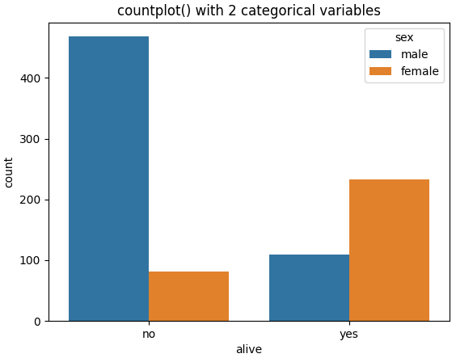
Seaborn – Categorical Plots: countplot()
countplot() applied to two categorical variables
Example: Show the number of passengers by gender split by survival (categorical variables 'sex' and 'alive')
sns.countplot(data=df_titanic, x='alive', hue='sex') plt.title("countplot() with 2 categorical variables") plt.show()
The same plot can be drawn using catplot() figure-level function:
sns.catplot(data=df_titanic, x='alive', hue='sex', kind='count', legend=False) plt.legend(title="sex", loc="upper right") plt.title("countplot() with 2 categorical variables") plt.tight_layout() plt.show()
Notes:
countplot():
When kwarg hue is set, countplot() does the following:
creates a new set of bars for each category (value) of the second categorical variable (here ‘sex’)
includes the legend to the plot, containing the title (the name of the categorical variable), and a colour for each of the category of the categorical variable).
catplot():
By default the value of kwarg legend is True. If there is a hue variable, a legend will be drawn on the plot. However, it may interfere with the bars. To control where the legend will appear use the legend() matplotlib function. Setting kwarg legend to False removes the default legend. The matplotlib legend() function includes it to the legend, offering an additional parameter: loc, to specify its location. The kwarg loc="upper right" displays the legend in the upper right corner. Other options are: 'upper left', 'lower left’ and 'lower right’. The kwarg title includes the title to the legend.
catplot() requires adjusting axis labels or titles that go outside the figure area and are thus clipped. tight_layout() matplotlib function takes care of that. To have an effect, make sure to call tight_layout() function after the data has been plotted and all the plot elements (i.e. the title, legend, etc.) for the plot have been set. Typically, it should be called immediately before showing the plot or saving the plot to a file.
The official documentation for catplot() function:
https://seaborn.pydata.org/generated/seaborn.catplot.html

Slide 26
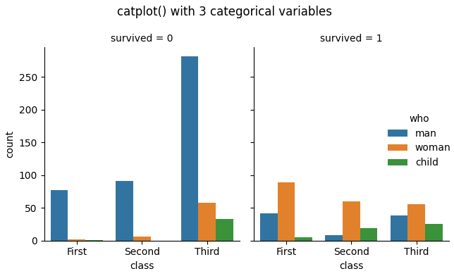
Seaborn – Categorical Plots: catplot()
To group within three categorical variables, use the figure-level function catplot()
Example: Show the number of passengers by class (1st, 2nd, 3rd), split by passenger types (man, woman, child), for each facet of survival (0, 1)
sns.catplot(data=df_titanic, x='class', hue='who', col='survived', kind='count')
plt.suptitle("catplot() with 3 categorical variables")
# display the plot
plt.tight_layout()
plt.show()
Notes:
The parameter hue is the data parameter around which the dependency of the passed data values are to be plotted. It allows including a second categorical variable. When hue is set, Seaborn will create a new set of bars for each category of the second categorical variable.
The parameter col specifies a column name from the data set to be used as a category for source of data to be displayed (here by variable survival). It allows including a third categorical variable. When col is set, Seaborn will create a separate subplot for each category of the third categorical variable. Effectively, the parameter col maps a third categorical variable to the plot column, creating a separate subplot for each category (value) of the third categorical variable
The matplotlib.pyplot function suptitle() is used to include the overall title for all subplots (“super title”).
The official documentation for FacetGrid() function:
https://seaborn.pydata.org/generated/seaborn.FacetGrid.html
The official documentation for FacetGrid.map() function:
http://seaborn.pydata.org/generated/seaborn.FacetGrid.map.html#seaborn.FacetGrid.map

Slide 27
Seaborn – Categorical Plots: catplot()
The example below illustrates how catplot() can be used to draw subplots over multiple rows
Example: Show the number of passengers by survival for each facet of deck.
import matplotlib.pyplot as plt
import pandas as pd
import seaborn as sns
# load the built-in 'titanic' data set into a data frame
df_titanic = sns.load_dataset("titanic")
# construct multiple plot in 4 columns showing the count of survivors by deck
sns.catplot(data=df_titanic, x='alive', col='deck', col_wrap=4, kind='count')
# display the plot
plt.tight_layout()
plt.show()
Notes:
As the name suggests, a count plot displays the number of observations in each category of your variable.
catplot() function can be used to create different plots for plotting categorical variables by changing its kind parameter. For the count plot, we set kind parameter to count and feed in the data using data parameter. The parameter col_wrap is used to specify the number of subplots in a row, allowing plots to span multiple rows (in case the number of subplots is greater than the number assigned to col_wrap).
The parameter kind determines the kind of plot to draw, corresponds to the name of a categorical axes-level plotting function. Options are: “strip”, “swarm”, “box”, “violin”, “boxen”, “point”, “bar”, or “count”.
The parameter col specifies a column name from the data set to be used as a category for source of data to be displayed (here by the titanic’s decks). When col is set, Seaborn will create a separate subplot for each category of the categorical variable (here ‘deck’).
The official documentation for catplot() function:
https://seaborn.pydata.org/generated/seaborn.catplot.html

Slide 28
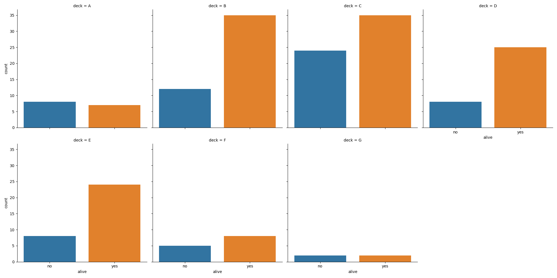
Seaborn – Categorical Plots: catplot()
Notes:
Since there are 7 decks (labelled A to G) and col_wrap is 4, the plot will have two rows with 4 subplots in the first and 3 subplots in the second row.
Note that x-axis labels (‘alive’) and values (‘no’, ‘yes’) relate to each column (not just the plot) – each of the 4 columns is labelled.

Slide 29
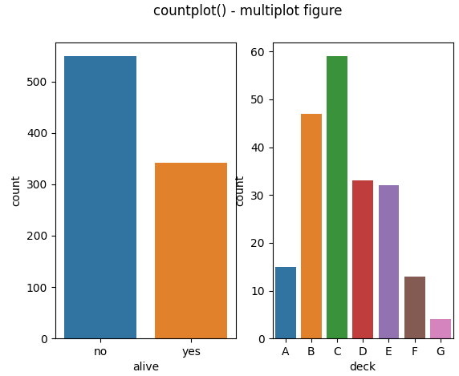
Seaborn – Categorical Plots: catplot()
To join multiple different axes-level plots into one figure use the subplots() matplotlib function
Example: Show the number of passengers in relation to the
1) categorical variable 'alive'
2) categorical variable 'deck'
fig, ax = plt.subplots(1,2)
sns.countplot(data=df_titanic, x='alive', ax=ax[0])
sns.countplot(data=df_titanic, x='deck', ax=ax[1])
plt.suptitle("countplot() - multiplot figure")
plt.show()
Notes:
Note: in this example, aside from x and data parameters, countplot() is passed the value for ax parameter: matplotlib Axes, axes object to draw the plot onto.
By default, ax is set to the current axes (determined by x, y and hue variables).
Seaborn figure-level plots are drawn on their own axes that are initiated when the plot is created. This means that we can’t use a Seaborn figure-level plots on existing axes. However, grids of plots can be easily created using axes-level plots.
Axes-level plots are Matplotlib objects that can be treated like any other Matplotlib figure. They can be bundled into a grid of subplots made with Matplotlib, which can be really useful when you are making lots of different plots. Besides easier to follow documentation, Matplotlib compatibility is one of axes-level plots’ greatest strengths.

Slide 30
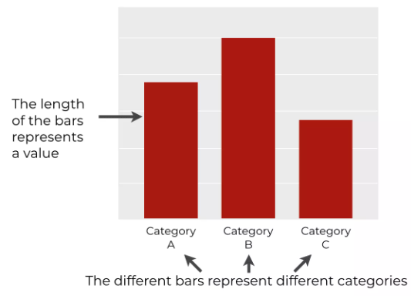
Seaborn – Categorical Plots: barplot()
barplot() axes-level function represents different categories from a categorical variable, where the height (for vertical bars) or length (for horizontal bars) of each bar represents a value of some metric for those categories
Typically, we use bar charts when we have at least one categorical variable and one numeric variable
barplot() function calculates a summary statistic for each category. By default, it calculates the mean
It is possible to change how sns.barplot summarizes the data by using the estimator parameter.
Moreover, if you know how to wrangle your data using Pandas, you can calculate even more complicated statistics
So when you want to count values, use countplot().
If you want to compare a metric across categories, use barplot()
Notes:
By default barplot() returns the average (mean) values of the numerical variable against the other (categorical) variable(s).
The official documentation for barplot() function:
https://seaborn.pydata.org/generated/seaborn.barplot.html

Slide 31
Seaborn – Categorical Plots: barplot()
Basic Syntax:
sns.barplot(data=, x=, y=, hue=, color=, estimator=)
data – maps to the dataset containing data to be used for plotting. Each column should correspond to a variable, and each row should correspond to an observation
x – maps a categorical (for vertical bar charts) or numerical (for horizontal bar charts) variable to the x-axis
y – maps a numerical (for vertical bar charts) or categorical (for horizontal bar charts) variable to the y-axis
hue – maps a second categorical variable to the “hue” of the bars, creating a new set of bars for each category (value) of the second categorical variable. All bars representing the same value of the 2nd categorical value will have the same colur – thus the number of different colours matches the number of different values of the 2nd categorical variable
color – sets the colour of each bar to the same (specified) colour
estimator – name of a statistical function to calculate values for each category of a categorical variable. The default value is ‘mean’, but it can be set to np.sum, len, np.median or any other statistical function
Notes:
Note: with barplot() one of the x or y parameters must be set to a numeric variable (in order to work out the average value by default, or a different value according to the function set by the kwarg estimator); the other must be set to a categorical variable. The kwarg hue allows adding an additional categorical variable.
The official documentation for barplot() function:
https://seaborn.pydata.org/generated/seaborn.barplot.html

Slide 32
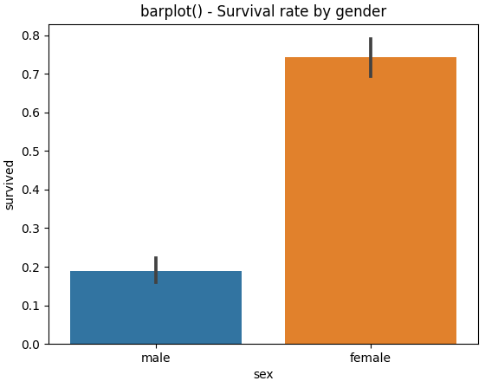
Seaborn – Categorical Plots: barplot()
Example: barplot() with one categorical and one numerical variable - Plot the dependency between categorical variable ‘sex’ and numerical variable ‘survived’ (the survival rate by gender)
import matplotlib.pyplot as plt
import pandas as pd
import seaborn as sns
# load the built-in 'titanic' data set into a data frame
df_titanic = sns.load_dataset("titanic")
# construct the plot
sns.barplot(data=df_titanic, x='sex', y='survived')
# display the plot
plt.show()
Notes:
Note: with barplot() one of the x or y parameters must be set to a numeric variable; the other must be set to a categorical variable.
For example, the following function call throws runtime error TypeError: Neither the ‘x’ nor ‘y’ variable appears to be numeric:
sns.barplot(x='sex', y='alive', data=df_titanic)
because both ‘sex’ and ‘alive’ are categorical. One of the parameters (x or y) must be numerical in order to work out the average value (the other must be categorical and the kwarg hue allows adding an additional categorical variable).
The values for this plot are calculated in the following way: the fixed variable here is ‘sex’. Therefore for each value of the variable ‘sex’, values of ‘survived’ column are added up and divided by the number of observations. There are 109 male survivors and 468 male who died. The values in the ‘survived’ column are added up for each male, resulting in adding up 109 values 1 with 468 values 0 (109 x 1 + 468 x 0 = 109). The number of observations are 109 + 468 = 577. The average value for ‘male’ bars is therefore 109 / 577 = 0.189
Similarly, the average value for ‘female’ bars is (233 x 1 + 81 x 0) / (233 + 81) = 233 / 314 = 0.742l
The vertical lines at the top of each bar are called error bars. Error bars are common in academic settings, but not as common in business settings. To remove them, set the ci ('confidence interval’) kwarg to None.
Set ci ('confidence interval' kwarg to None to remove error bars and avoid bootstrapping.
[bootstrapped is a Python library that allows you to build confidence intervals from data]
For more info on building confidence interval using Python's NumPy:
https://medium.com/swlh/building-confidence-interval-using-pythons-numpy-b96cd6e7f2d4

Slide 33

Seaborn – Categorical Plots: catplot()
The same plot can be drawn using catplot() function, setting the kind kwarg to 'bar’:
# construct the plot
sns.catplot(data=df_titanic, x='sex', y='survived', kind='bar')
# display the plot
plt.tight_layout()
plt.show()

Slide 34
Seaborn – Categorical Plots: barplot()
Example: barplot() with two categorical and one numerical variable - Plot the dependency between categorical variable ‘sex’ and numerical variable ‘survived’ against the categorical variable ‘class’(the survival rate by gender split by class)
# load the built-in 'titanic' data set into a data frame
df_titanic = sns.load_dataset("titanic")
# construct the plot
sns.barplot(data=df_titanic, x='sex', y='survived', hue='class', order=['female', 'male'], ci=None)
# display the plot
plt.title("Survival rate by gender grouped by class")
plt.show()
Notes:
The order (hue_order) kwarg is used to change the order in which to plot the categorical values of the categorical variables. By default, the order of categorical values is inferred from the data objects. In this example order is used to change the order in which to plot values of the categorical variable ‘sex’ (first ‘female’, then ‘male’).
The values for this plot are calculated in the following way: the fixed variables here are ‘sex’ and ‘class’. Therefore for each pair of values (‘sex’, ‘class’), values of ‘survived’ column are added up and divided by the number of observations. The numbers of male survivors in classes 1, 2 & 3 respectively are 45, 17 & 47. The number male deaths in classes 1, 2 & 3 respectively are 77, 91 & 300. The values in the ‘survived’ column are added up for each male and class, resulting in adding up 45 values 1 with 77 values 0 for the first class (45 x 1 + 77 x 0 = 45). The number of observations of male passengers in first class are 45 + 77 = 122. The average value for (’male’, ‘First’) bars is therefore 45 / 122 = 0.3689
Similarly, the average value for (‘female’, ‘First’) bars is (91 x 1 + 3 x 0) / (91 + 3) = 91 / 94 = 0.9680
The remaining combinations: (‘male’, ‘Second’), (‘female’, ‘Second’), (‘male’, ‘Third’) & (‘female’, ‘Third’) are calculated in similar fashion:
(‘male’, ‘Second’) = (17 x 1 + 91 x 0) / (17 + 91) = 0.1574
(‘female’, ‘Second’) = (70 x 1 + 6 x 0) / (70 + 6) = 0.9210
(‘male’, ‘Third’) = (47 x 1 + 300 x 0) / (47 + 300) = 0.1354
(‘female’, ‘Third’) = (72 x 1 + 72 x 0) / (72 + 72) = 0.5

Slide 35
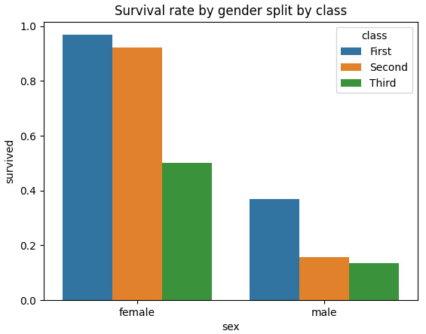
Seaborn – Categorical Plots: barplot()
When kwarg hue is set, barplot() does the following:
creates a new set of bars for each value of the second categorical variable (here ‘class’)
includes the legend to the plot, containing the title (the name of the categorical variable), and a colour for each of the category of the categorical variable).
Seaborn function color_palette() can
be used to change bar colours, otherwise
Seaborn will use a default set of colours (see
slide 74), the first three of which are blue,
orange and green.
Notes:
(‘female’, ‘First’) = (91 x 1 + 3 x 0) / (91 + 3) = 0.9680
(‘female’, ‘Second’) = (70 x 1 + 6 x 0) / (70 + 6) = 0.9210
(‘female’, ‘Third’) = (72 x 1 + 72 x 0) / (72 + 72) = 0.5
(’male’, ‘First’) = (45 x 1 + 77 x 0 / (45 + 77) = 0.3689
(‘male’, ‘Second’) = (17 x 1 + 91 x 0) / (17 + 91) = 0.1574
(‘male’, ‘Third’) = (47 x 1 + 300 x 0) / (47 + 300) = 0.1354

Slide 36
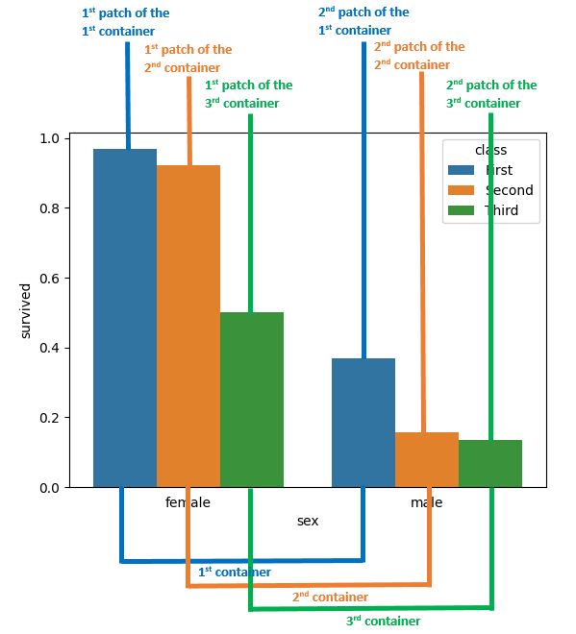
Patches & Containers
Patch is the graphical shape used to represent data in a plot (such as one bar in a bar plot)
Containers are classes that collect semantically related artists such as the set of bars in a bar plot
The container can be treated as a tuple of patches
Containers are associated to the different values of the categorical variable set by the kwarg hue
Each container is a collection of bars for the same value of the categorical variable assigned to kwarg hue
In this example there are 3 containers: one for each value of the variable class (First, Second, Third)
In this example there are 6 patches: one for each gender (female, male), within each of the 3 containers
Each patch within a container represents one value of the categorical variable assigned to one of the parameters: x or y
Notes:
In the example above there are 3 containers – one for each value of the categorical variable ‘class’ assigned to kwarg hue. Each container groups together bars of the same class:
The first container is a collection of bars for the value ‘First’ of the categorical variable ‘class’ assigned to kwarg hue (the collection of blue bars).
The second container is a collection of bars for the value ‘Second’ of the categorical variable ‘class’ assigned to kwarg hue (the collection of orange bars).
The third container is a collection of bars for the value ‘Third’ of the categorical variable ‘class’ assigned to kwarg hue (the collection of green bars).
There are 6 patches: one for each value assigned to the categorical variable x (‘sex’):
The first patch represents the value ‘female’ of the categorical variable ‘sex’, within the container for the value ‘First’ of the variable ‘class’.
The second patch represents the value ‘male’ of the categorical variable ‘sex’, within the container for the value ‘First’ of the variable ‘class’.
The third patch represents the value ‘female‘ of the categorical variable ‘sex’, within the container for the value ‘Second’ of the variable ‘class’.
The fourth patch represents the value ‘male’ of the categorical variable ‘sex’, within the container for the value ‘Second’ of the variable ‘class’.
The fifth patch represents the value ‘female’ of the categorical variable ‘sex’, within the container for the value ‘Third’ of the variable ‘class’.
The sixth patch represents the value male of the categorical variable ‘sex’, within the container for the value ‘Third’ of the variable ‘class’.

Slide 37
Seaborn – Displaying numbers on bars
For single-group axes-level plots (without 'hue'), pass the single bar container to the bar_label() method
# store the matplotlib Axes object returned by axes-level function (e.g. barplot)
ax = sns.barplot(data=df_titanic, x='sex', y='survived', ci=None)
# include numbers on top of the bars, formatted with 3 decimal places
ax.bar_label(ax.containers[0], fmt='%.3f', label_type='edge')
# or just
ax.bar_label(ax.containers[0], fmt='%.3f')
# since 'edge' is the default value for label_type kwarg
# include numbers in the centre of the bars
ax.bar_label(ax.containers[0], fmt='%.3f', label_type='center')
# set the title and display the plot
plt.title("Survival rate by gender\n(single-group axes-level plot with numbers on bars)")
plt.show()
Notes:
In the example above there are two patches: one for the value ‘male’ of the categorical variable ‘sex’, and the other for the value ‘female’ of the categorical variable ‘sex’. There is only one container, containing both patches.
Plots with one container are called single-group plots.
For single-group plots there is only one bar container, accessible through index 0: ax.containers[0]
The average value for ‘male’ bars: (109 x 1 + 468 x 0) / (109 + 468) = 109 / 577 = 0.189
The average value for ‘female’ bars: (233 x 1 + 81 x 0) / (233 + 81) = 233 / 314 = 0.742

Slide 38
Seaborn – Displaying numbers on bars
For multi-group axes-level plots (with 'hue'), iterate through multiple bar containers:
# store the matplotlib Axes object returned by axes-level function (e.g. countplot)
ax = sns.countplot(data=df_titanic, x='alive', hue='sex')
# iterate through containers (groups), identified by hue kwarg
for container in ax.containers:
# include numbers on top of the bars
ax.bar_label(container, label_type='edge')
# include numbers in the centre of the bars
ax.bar_label(container, label_type='center')
# set the title, adjust and display the plot
plt.title("Total number of dead & alive passengers split by gender\n (multi-group axes-level plot with numbers on bars)")
plt.tight_layout()
plt.show()
Notes:
In the example above there are two containers, one for the value ‘male’ of the categorical variable ‘sex’ (the collection of blue bars), and the other for the value ‘female’ of the categorical variable ‘sex’ (the collection of orange bars).
The first container is accessible through index 0: ax.containers[0]
The second container is accessible through index 1: ax.containers[1]
There are four patches:
The first patch, representing the value ‘no’ of the categorical variable ‘alive’, within the container for the value ‘male’ of the categorical variable ‘sex’.
The second patch, representing the value ‘yes’ of the categorical variable ‘alive’, within the container for the value ‘male’ of the categorical variable ‘sex’.
The third patch, representing the value ‘no’ of the categorical variable ‘alive’, within the container for the value ‘female’ of the categorical variable ‘sex’.
The fourth patch, representing the value ‘yes’ of the categorical variable ‘alive’, within the container for the value ‘female’ of the categorical variable ‘sex’.
Plots with multiple containers are called multi-group plots.
The above code will work for any single/multi group axes-level plot with bars.
Note: for single-group axes-level plots (without 'hue'), the loop will run once only.
countplot() counts the rows for each different value of (‘alive’, ‘sex’) pair, that is:
(‘no’, ‘male’) = 468 (because 468 male died)
(‘no’, ‘female’) = 81 (because 81 female died)
(‘yes’, ‘male’) = 109 (because 109 male survived)
(‘yes’, ‘female’) = 233 (because 233 female survived)
The loop iterates through the containers of each category of the categorical variable set by the hue parameter. In this case, through values ‘male’ and ‘female’. The loop could have been replaced by these statements:
ax.bar_label(ax.containers[0], label_type='edge’) # values for 'male' bars displayed on top of the bars
ax.bar_label(ax.containers[0], label_type='center') # values for 'male' bars displayed in centre of the bars
ax.bar_label(ax.containers[1], label_type='edge’) # values for 'female' bars displayed on top of the bars
ax.bar_label(ax.containers[1], label_type='center’) # values for 'female' bars displayed in centre of the bars

Slide 39
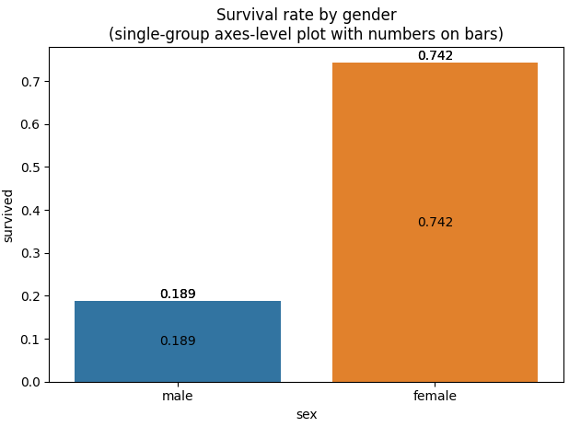
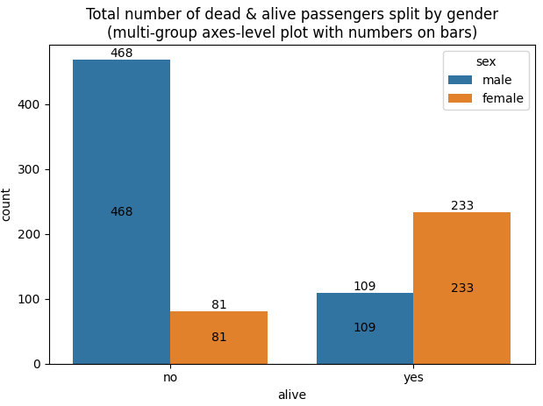
Seaborn – Displaying numbers on bars
Including numbers in the centre and on top of the bars for single-group bar plots (without 'hue’) – code from slide 37
Including numbers in the centre and on top of the bars for multi-group bar plots (with 'hue') – code from slide 38
Notes:
Note: normally numbers on bars will be displayed either on top or in the centre of the bar (not both). Here numbers are displayed in both places for illustration only.
Values for the first subplot:
The average value for ‘male’ bars: (109 x 1 + 468 x 0) / (109 + 468) = 109 / 577 = 0.189
The average value for ‘female’ bars: (233 x 1 + 81 x 0) / (233 + 81) = 233 / 314 = 0.742
Values for the second subplot:
(‘no’, ‘male’) = 468 (because 468 male died)
(‘no’, ‘female’) = 81 (because 81 female died)
(‘yes’, ‘male’) = 109 (because 109 male survived)
(‘yes’, ‘female’) = 233 (because 233 female survived)

Slide 40
Seaborn – Displaying numbers on bars
For single-plot figure-level plots (without 'col'), iterate through containers of the plot
# store the FaceGrid object returned by figure-level function (e.g. catplot)
fg = sns.catplot(data=df_titanic, x='sex', y='survived', kind='bar', ci=None)
# store the matplotlib Axes subplot objects returned by FacetGrid.facet_axis()
# here axis are present in row 0 and column 0 (since there are no subplots)
ax = fg.facet_axis(0, 0)
# iterate through containers, identified by hue kwarg
for container in ax.containers:
# include numbers on top of the bars
ax.bar_label(container, fmt='%.3f', label_type='edge')
# include numbers in the centre of the bars
ax.bar_label(container, fmt='%.3f', label_type='center')
Notes:
The official documentation for FacetGrid.facet_axis() function:
http://seaborn.pydata.org/generated/seaborn.FacetGrid.facet_axis.html
Syntax for facet_axis() function:
FacetGrid.facet_axis(self, row_i, col_j, modify_state=True)
facet_axis() function makes the axis identified by these indices active and returns it. Here axis are present in row 0 and column 0 (since there are no subplots).
ax can now be used to label the bars (through its containers).
Note: bar plot (here set through the ‘kind’ kwarg), returns mean values by default. Calculating the mean (average) involves division, which produces a float value with potentially many decimal places. To round these values fmt kwarg is used.
The above plot does not involve hue, and therefore the loop will run once only. The loop could have been replaced by the following two statements:
ax.bar_label(ax.containers[0], fmt='%.3f', label_type='edge')
ax.bar_label(ax.containers[0], fmt='%.3f', label_type='center')

Slide 41
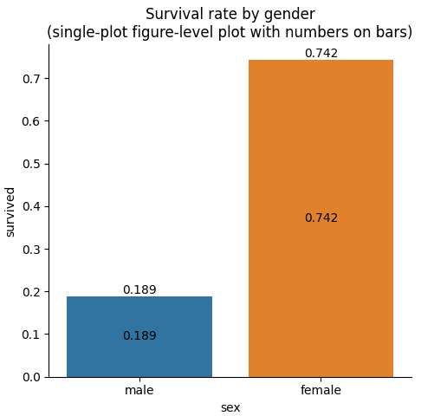
Seaborn – Displaying numbers on bars
plt.title("Survival rate by gender\n(single-plot figure-level plot with numbers on bars)")
plt.tight_layout()
plt.show()
Notes:
Note: in the above code the loop will run once only (as there is one container only). It will work for multi-group single-plot figure-level plots (with 'hue') as well; for example try it on:
fg = sns.catplot(data=df_titanic, x='alive', hue='class', kind='count', ci=None)
In this case the count plot would be created (through the ‘kind’ kwarg). Since count always returns integer values, there would be no need for rounding values (fmt kwarg can therefore be omitted).

Slide 42
Seaborn – Displaying numbers on bars
For multi-plot figure-level plots (with 'col'), iterate through multiple axes (subplots) and for each subplot iterate through its containers
# store the FaceGrid object returned by figure-level function (e.g. catplot)
fg = sns.catplot(data=df_titanic, x='class', hue='who', col='survived', kind='count', height=6, aspect=.8, ci=None)
# iterate through axes (subplots), identified by col kwarg
for ax in fg.axes.ravel():
# within each subplot iterate through its containers, identified by hue kwarg
for container in ax.containers:
# include numbers on top of the bars
ax.bar_label(container, label_type='edge')
# include numbers in the centre of the bars
ax.bar_label(container, label_type='center')
Notes:
The above code will work for any single/multi figure-level plot with bars.
Note: here both hue and col kwargs are set, hence both loops are going to be executed more than once.

Slide 43
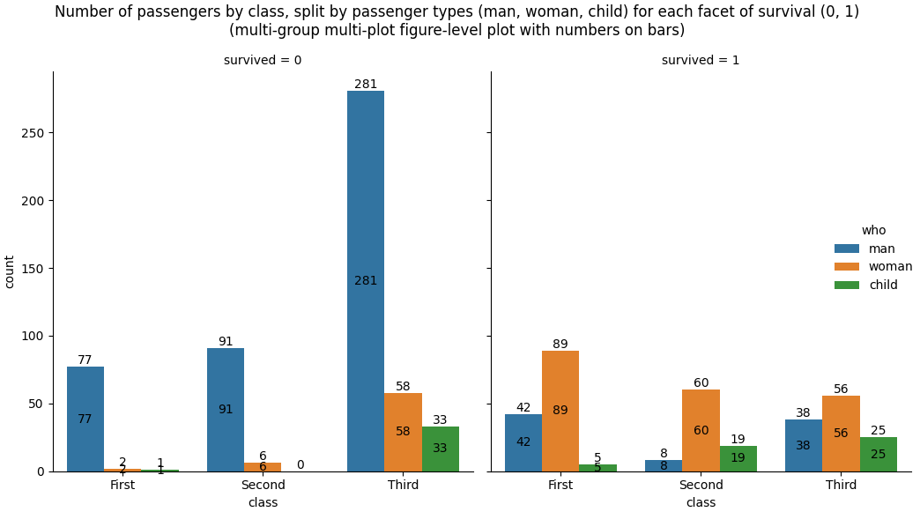
Seaborn – Displaying numbers on bars
Notes:
Note: this example illustrates the benefit of displaying values on top of the bars, rather than in the centre. Sometimes the bars are not high enough to display the value in the centre. For example, in the above plot there are 2 women and 1 child from the first class who did not survive – none of these values can be displayed in the centre of its bars. There is also no child from the second class who did not survive – hence there is no bar for this value (0 can only be displayed on top).
The values for this plot are calculated in the following way: the fixed variables here are ‘class’, ‘who’ and ‘survived’. Therefore countplot() counts records for each different combination of (‘class’, ‘who’, ‘survived’). For example:
(‘First’, ‘man’, 0) = 77
(‘First’, ‘woman’, 0) = 2
(‘First’, ‘child’, 0) = 1

Slide 44
Seaborn – Axes-level vs Figure-level plots
There are three noticeable “cosmetic” differences between axes-level and figure level functions:
Axes-level functions include the top and right borders (“spines”) to the plot; figure-level functions don’t
Axes-level functions include the legend inside the plot; figure-level functions include it outside the plot
They have a slightly different shape: axes-level plots tend to have a square shape, while figure-level plots have a rectangular shape, with its height slightly greater than its width, and therefore often require adjusting the image through the mathplotlib function pyplot tight_layout()
For various reasons, it may be useful to remove the spines from plot(s) created with axes-level functions (for example, when some of the bars are too high to fit its value(s) above the bars and below the top plot spine)
To remove any of the spines from plot(s) use the Seaborn despine() function:
sns.despine(top=True, right=True, left=False, bottom=False)
Note: the despine() function must be called after the plot function call.
Notes:
The official documentation for despine() function:
https://seaborn.pydata.org/generated/seaborn.despine.html#seaborn.despine

Slide 45
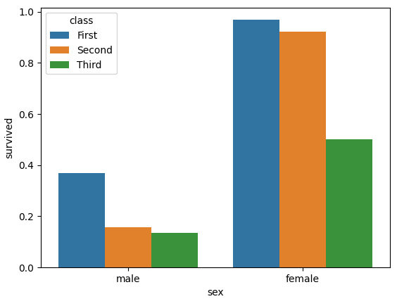
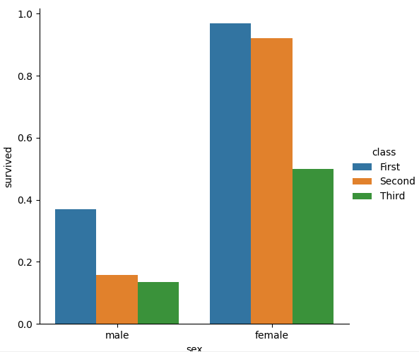
Seaborn – Axes-level vs Figure-level plots
An axes-level plot created with barplot() (left) and its equivalent figure-level plot using catplot() (right)
sns.barplot(data=df_titanic, x='sex', y='survived', hue='class', ci=None)
sns.catplot(data=df_titanic, x='sex’, y='survived', hue='class', kind=‘bar', ci=None)
Notes:
Note the differences:
1) the plot created with barplot() includes all four spines, while the plot created with catplot() has only left and bottom spines (which are the x and y axes)
2) the legend with barplot() is inside the plot, while the legend with catplot() is outside the plot
3) the plot created with barplot() has a square shape, while the plot created with catplot() has a rectangle shape, with the height slightly longer than the width
4) the x-axis label (‘sex’) is not entirely displayed in the plot created with catplot() – this can be fixed by calling the plt.tight_layout() function just before displaying or saving the plot

Slide 46
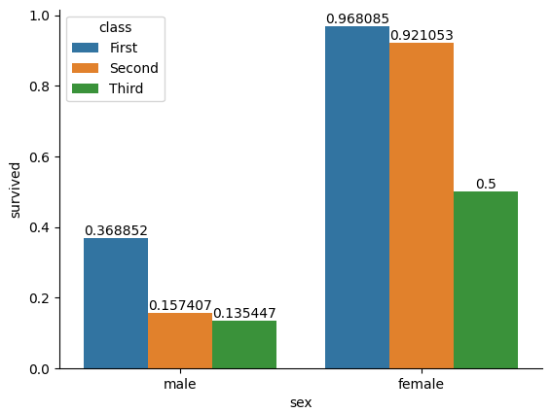
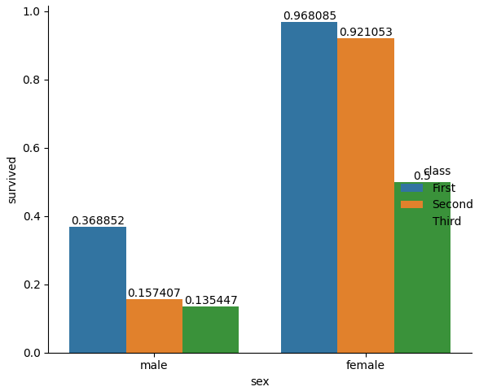
Seaborn – Axes-level vs Figure-level plots
The plots on this slide illustrate the effect of despine() applied to the plot created with barplot (left) and the effect of calling the tight_layout() function just before displaying the plot created with catplot() (right)
ax = sns.barplot(data=df_titanic, x='sex', y='survived', hue='class', ci=None)
for container in ax.containers:
ax.bar_label(container, label_type='edge')
sns.despine()
fg = sns.catplot(data=df_titanic, x='sex', y='survived', hue='class', kind='bar', ci=None)
for container in fg.ax.containers:
fg.ax.bar_label(container, label_type='edge')
plt.tight_layout()
Notes:
Note the consequence of applying despine() to the plot created with barplot() function:
the top and right borders have been removed (because of the default parameters for the function):
sns.despine(top=True, right=True, left=False, bottom=False)
Note the consequences of applying tight_layout() to the plot created with catplot() function:
the whole plot now has a square shape
the x-axis label (‘sex’) is now fully displayed
the legend is now squeezed inside the plot but overlaps the last bar – to fix this we need to hide the existing legend - by setting the kwarg legend to False and by creating a new legend and positioning it in a desired location (using the plt.legend() function:
fg = sns.catplot(data=df_titanic, x='sex', y='survived', hue='class', kind='bar', legend=False, ci=None)
plt.legend(title=‘class', loc="upper left")
In both cases, numbers can be safely displayed on top of the bars, as there is no top spine.

Slide 47
Seaborn – Pandas query with barplot() (1)
Example: show the number of dead & alive passengers split by gender (categorical variables 'alive' and 'sex') – solution using query()
import matplotlib.pyplot as plt
import pandas as pd
import seaborn as sns
# calculate the number of alive/dead female/male passengers
alive_f_count = df_titanic[['sex', 'alive']].query('sex=="female" and alive=="yes"').count()
alive_m_count = df_titanic[['sex', 'alive']].query('sex=="male" and alive=="yes"').count()
dead_f_count = df_titanic[['sex', 'alive']].query('sex=="female" and alive=="no"').count()
dead_m_count = df_titanic[['sex', 'alive']].query('sex=="male" and alive=="no"').count()
Notes:
Note: this is the same task as in slide 25, but using barplot() instead of countplot() / catplot()

Slide 48
Seaborn – Pandas query with barplot() (2)
# create the data frame with these calculated values
df_totals = pd.DataFrame({
'gender': ['male', 'female', 'male', 'female'],
'alive': ['no', 'no', 'yes', 'yes'],
'count': [dead_m_count[0], dead_f_count[0], alive_m_count[0], alive_f_count[0]]
})
# construct the plot
ax = sns.barplot(data=df_totals, x='alive', y='count', hue='gender')
# include numbers in the centre of the bars
ax.bar_label(ax.containers[0], label_type='center') # values for 'male' bars
ax.bar_label(ax.containers[1], label_type='center') # values for 'female' bars
Notes:
>>> print(df_totals)
gender alive count
0 male no 468
1 female no 81
2 male yes 109
3 female yes 233
Note: hue=‘gender’ causes creating a new set of bars for each category (value) of the categorical variable ‘gender’. Since values on x-axis are categories (values) of the categorical variable ‘alive’ (‘no’, ‘yes’), each of them will be represented with 2 bars: one for ‘male’ and another for ‘female’.

Slide 49

Seaborn – Pandas query with barplot() (3)
# display the plot
plt.title("Total number of dead & alive passengers split by gender\n- using query()")
plt.tight_layout()
plt.show()
Note: this is the same task as in slide 25, but using barplot() instead of countplot() / catplot()
This highlights the importance of choosing the most appropriate function for a given task
barplot() displays values, but since these values are not present in the initial data set, they had to be calculated
Notes:
Notice the importance of the order of values in the data frame with their appearance on the plot: the plot needs to show the number of dead people first, then alive, hence the data frame lists first dead values, then alive. Within each ‘alive’ category, the plot needs to display first male then female bars – hence male values are listed before female.

Slide 50
Seaborn – Pandas groupby with barplot() (1)
Example: show the number of dead & alive passengers split by gender (categorical variables 'alive' and 'sex’) – solution using groupby()
# calculate the number of alive/dead female/male passengers
df_totals = df_titanic.groupby(['sex','alive'])['survived'].count().reset_index()
print(df_totals)
# draw the plot
ax = sns.barplot(data=df_totals, x='alive', y ='survived', hue='sex')
# include numbers in the centre of the bars
ax.bar_label(ax.containers[0], label_type='center') # values for 'female' bars
ax.bar_label(ax.containers[1], label_type='center') # values for 'male' bars
plt.title("Total number of dead & alive passengers split by gender\n- using groupby()")
plt.tight_layout()
plt.show()
Notes:
Without applying the reset_index() method, the result would have been Series, not a DataFrame.
s_totals = df_titanic.groupby(['sex','alive'])['survived'].count()
The Series s_totals would look like this:
sex alive
female no 81
yes 233
male no 468
yes 109
We can access series’ elements using the subscript operator in four ways:
passing the index position of each row directly to the Series: s_totals[0] returns 81; s_totals[1] returns 233 etc.
passing the index label of each row directly to the Series: s_totals[('female', 'no’)] returns 81, s_totals[('female', 'yes’)] returns 233 etc.
through iloc property, passing to it the index position of each row: s_totals.iloc[0] returns 81; s_totals.iloc[1] returns 233 etc.
through loc property, passing to it the index label of each row: s_totals.loc[('female', 'no’)] returns 81, s_totals.loc[('female', 'yes’)] returns 233 etc.
In order to draw a plot, we need x-axis values as 'female' and 'male’ in all rows. Essentially, we need a DataFrame with 3 columns: one named 'sex’, listing different sex values: 'female' and 'male', the second column (named ‘alive’) listing values ‘no’ and ‘yes’ and the third column (named ‘survived’) listing the number of survivors and deaths by each gender. The reset_index() method will do just that, including the row index 0 and 1 to the left, creating the DataFrame object:
sex alive survived
0 female no 81
1 female yes 233
2 male no 468
3 male yes 109

Slide 51
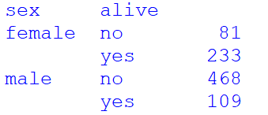
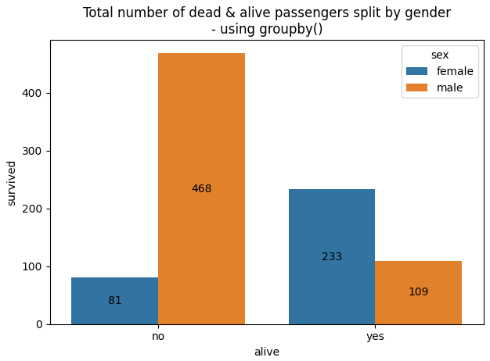
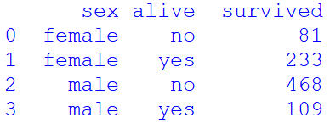
Seaborn – Pandas groupby with barplot() (2)
The plot produced by the code in the previous slide is shown below
The image above shows the series object created without applying the reset_index() method
The image below shows the df_totals DataFrame object, produced after applying the reset_index() method
Notes:
Note:
When we reset the index, the old index is added as (converted to/split into) column(s), and a new sequential index (0, 1, 2, …) is used. If the old index consist of one column it is converted to one column; if it consists of multiple columns it is converted to multiple columns.
The reset_index() method therefore does two things:
converts the old index to column(s)
adds a new sequential index
If applied to a Series, reset_index() method produces a DataFrame, as illustrated in the above example.
We can use the drop parameter to avoid the old index being added as column(s):
df.reset_index(drop=True)
Example:
>>> s_totals = df_titanic.groupby(['sex','alive'])['survived'].count()
>>> df_totals = s_totals.reset_index(drop=True)
>>> totals = s_totals.reset_index(drop=True)
>>> print(totals)
0 81
1 233
2 468
3 109
Name: survived, dtype: int64
The produced data structure is a Series:
>>> print(type(totals))
<class 'pandas.core.series.Series'>
To remove only specific columns, use the del statement:
>>> s_totals = df_titanic.groupby(['sex','alive'])['survived'].count()
>>> df_totals = s_totals.reset_index()
>>> print(df_totals)
>>> del df_totals['alive’]
>>> print(df_totals)
sex survived
0 female 81
1 female 233
2 male 468
3 male 109
Of course, in this case such operation would not make sense, as now the removed column makes it unclear what values relate to the survived and to the non-survived passengers by gender.

Slide 52
Seaborn – Pandas groupby with barplot() (3)
To make the plot look exactly the same task as in slide 45, the order of the values: male and female needs to be swapped around (the default order is inferred from the data objects - here the DataFrame df_titanic)
# create a dataframe with sex values sorted in the descending order
df_totals = df_titanic.groupby(['sex', 'alive'])['survived'].count().reset_index(). sort_values(by='sex', ascending=False)
print(df_totals)
# draw the plot
ax = sns.barplot(data=df_totals, x='alive', y ='survived', hue='sex')
# include numbers in the centre of the bars
ax.bar_label(ax.containers[0], label_type='center') # values for 'male' bars
ax.bar_label(ax.containers[1], label_type='center') # values for 'female' bars
plt.title("Total number of dead & alive passengers by gender")
plt.tight_layout()
plt.show()
Notes:
Note: in the first line of code above :
df_totals = df_titanic.groupby(['sex', 'alive'])['survived'].count().reset_index(). sort_values(by='sex', ascending=False)
the sort_values(by='sex', ascending=False) method sorts values of the column specified as first parameter in order specified as second parameter.
In this example we sorted values of column ‘sex’ in descending order, so that ‘male’ are listed before ‘female’. The resulting dataset df_totals is:
sex alive survived
2 male no 468
3 male yes 109
0 female no 81
female yes 233
When df_totals is passed to the barplot() function it will cause male bars to appear before the female bars, and therefore male bars will be blue, while female will be orange.

Slide 53
Seaborn – Pandas groupby with barplot() (4)
When values of a column in a DataFrame need to be sorted in ascending or descending order, the solution shown in previous slide is suitable. However, sometimes we might need a custom sort. In this case, we need to pass the list with values sorted in desired order to the Pandas function Categorical, as shown below
df_totals = df_titanic.groupby(['sex', 'alive'])['survived'].count().reset_index()
print(df_totals)
# compose the list with sex values sorted in the desired order
sorted_sex = ['male', 'female']
# change the order of the sex values according to the order given in the list supplied to the kwarg categories (Categorical function is used to convert/typecast integer or character column to categorical in Pandas Python)
df_totals.sex = pd.Categorical(df_totals.sex, categories=sorted_sex)
# readjust the index to a new sequential index that will correspond to the sex values sorted according to the new given order (in the sorted_sex list)
df_totals = df_totals.groupby(['sex', 'alive'])['survived'].sum().reset_index()
print(df_totals)
Notes:
Note: in the first line of code above :
df_totals = df_titanic.groupby(['sex', 'alive'])['survived'].count().reset_index()
groupby() and count() are applied to the df_titanic DataFrame. count() is applied to every different value of ('sex', 'alive'), which returns the number of records for each different pair of values. This number will correspond to the number of survived for each different pair of values (because every record related to a survived person will have value 1 in the ‘survived’ column and every record related to a person that did not survive will have value 0 in the ‘survived’ column.
Note also that using sum() in place of count() would cause adding up all values in the ‘survived’ column of the df_titanic DataFrame. This would result in correct values for the survived passengers, but for passengers who did not survive sum would produce 0, as it would add up zeroes present in the ‘survived’ column for noon-survivors. The resulting DataFrame after applying sum() would therefore be:
sex alive survived
0 female no 0
1 female yes 233
2 male no 0
3 male yes 109
When readjusting the df_totals DataFrame, in the line before the last:
df_totals = df_totals.groupby(['sex', 'alive'])['survived'].sum().reset_index()
groupby() and sum() are applied to the df_totals DataFrame. Using count() instead of sum() would return 1 for every different value of ('sex', 'alive'), as there is one record for every different value of ('sex', 'alive').
df_totals looks like this:
sex alive survived
0 female no 81
1 female yes 233
2 male no 468
male yes 109
There is 1 record for every different value of ('sex', 'alive'):
(‘female’, ‘no’) = 1
(‘female’, ‘yes’) = 1
(‘male’, ‘no’) = 1
(‘male’, ‘yes’) = 1
The resulting DataFrame after applying count() would therefore be:
sex alive survived
0 male no 1
1 male yes 1
2 female no 1
female yes 1
The function Categorical causes reordering female and male rows so that male values come before female.
On the other hand, applying sum() to df_totals returns the correct DataFrame because values in the ‘survived’ column for every different value of ('sex', 'alive') are added up. Since there is only one value in the ‘survived’ column for each combination, that value will be saved.
The resulting DataFrame after applying sum() will therefore be:
sex alive survived
0 male no 468
1 male yes 109
2 female no 81
female yes 233

Slide 54

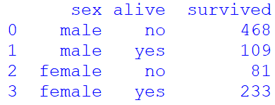
Seaborn – Pandas groupby with barplot() (5)
# draw the plot
ax = sns.barplot(data=df_totals, x='alive', y ='survived', hue='sex')
# include numbers in the centre of the bars
ax.bar_label(ax.containers[0], label_type='center') # values for 'male' bars
ax.bar_label(ax.containers[1], label_type='center') # values for 'female' bars
plt.title("Total number of dead & alive passengers split by gender\n- using groupby() and custom sorting using Categorical()")
plt.tight_layout()
plt.show()
The readjusted DataFrame (above) and the final plot (on the right)

Slide 55
Seaborn – Pandas groupby with barplot() (6)
The solution shown in the two previous slides can be improved by running the Categorical() function directly against the sex column of the df_titanic DataFrame. This way the groupby() and aggregation are executed once only
# run the Categorical() function directly against the sex column of the df_titanic
df_titanic.sex = pd.Categorical(df_titanic.sex, categories=['male', 'female'])
# calculate the number of alive/dead female/male passengers df_totals = df_titanic.groupby(['sex', 'alive'])['survived'].count().reset_index()
print(df_totals)
sex alive survived
0 male no 468
1 male yes 109
2 female no 81
3 female yes 233
type(df_totals)
<class 'pandas.core.frame.DataFrame'>

Slide 56
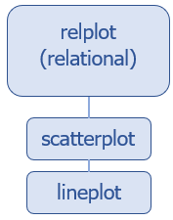
Seaborn – Data Relationship
Statistical analysis is a process of understanding how variables in a dataset relate to each other and how those relationships depend on other variables.
Relational plots are used for visualizing the statistical relationship between the data points. They show the relationship between multiple variables in a dataset.
relpot() is a figure-level function for visualizing statistical relationships using two common approaches: scatter plots and line plots.
Through the kind keyword argument, relpot() combines a FacetGrid with one of the two axes-level functions:
scatterplot() (with kind="scatter"; the default)
lineplot() (with kind="line")
Notes:
Official Seaborn documentation on relational plots:
https://seaborn.pydata.org/tutorial/relational.html

Slide 57
Seaborn – Relational Plots: scatterplot()
scatterplot() function depicts the relationship between a numeric value and a categorical group of values together
Basic Syntax:
scatterplot(data=, x=, y=, hue=)
data: the pointer variable wherein the entire data is stored (the name of the data set)
x: data variable that needs to be plotted on the x-axis (the name of the categorical variable)
y: the data variable to be plotted on the y-axis (the name of the numerical variable)
hue: grouping variable that will produce points with different colours. Can be either categorical or numeric, although colour mapping will behave differently in latter case.
As usual, we can make use of various parameters such as ‘palette‘, ‘style‘, ‘size‘ and ‘markers‘ to enhance the plot and avail a much better pictorial representation of the plot.
Notes:
Official Seaborn documentation on relational plots:
https://seaborn.pydata.org/generated/seaborn.scatterplot.html

Slide 58
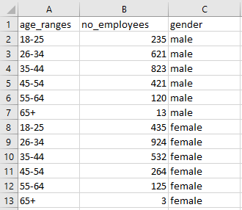
Seaborn – Relational Plots: scatterplot()
Scatter plot can be used to depict the relationship between two data variables against the third variable of the data set
Example: plot the relationship between the ‘age_ranges‘ and ‘no_employees' against the ‘gender’, using scatter plot
The data set in this example is stored in a csv file: employees.csv, shown on the right

Slide 59
Seaborn – Relational Plots: scatterplot()
import matplotlib.pyplot as plt
import pandas as pd
import seaborn as sns
# get the data set from csv file
data_set = pd.read_csv("employees.csv")
# create a scatter plot
# plot the dependency between 'age_ranges' and 'no_employees'
# data variables against the data variable 'gender' of the dataset
sns.scatterplot(data=data_set, x='age_ranges', y='no_employees', hue='gender')
# save the plot into a file
plt.savefig('scatter_plot.png')
Notes:
Note: hue is the data parameter around which the dependency of the passed data values are to be plotted.
The same plot can be drawn using the figure-level function relplot() and setting its kind kwarg to ‘scatter’:
sns.relplot(data=data_set, x='age_ranges', y='no_employees', hue='gender', kind='scatter')

Slide 60
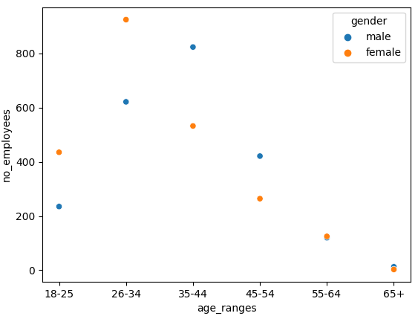
Seaborn – Relational Plots: scatterplot()
The resulting plot is shown below
Some of the data points can overlap, as is the case here with the no of male and female employees in the last two age ranges
This can be improved with a parameter style, which draws points using different patterns: o and x.
Another way of improving it is by using the parameter size, which draws points using different sizes
Both ways are illustrated in the next two slides
Notes:
Note: without assigning the value ‘gender’ to the hue keyword argument, the plot would show the same points in one colour (blue). By including the hue keyword argument, the points related to the two gender values (male, female) are shown in first two colours of the Seaborn default colour palette: blue (for male) and orange (for female). Colours can be changed through the palette keyword argument in a number of ways, for example:
Assign an existing Seaborn palette to the keyword argument palette, for example palette="deep“ (see slides 63 and 66 for the list of existing palettes)
Create a dictionary associating a desired colour for each gender and assign the dictionary name to the palette keyword argument, for example:
gender_palette = {"male":"green", "female":"yellow"}
sns.scatterplot(data=data_set, x='age_ranges', y='no_employees', hue='gender', palette=gender_palette)

Slide 61
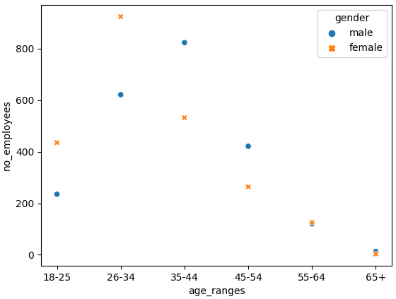
Seaborn – Relational Plots: scatterplot()
sns.scatterplot(data=data_set, x='age_ranges', y='no_employees', hue='gender', style='gender')
The 'style' parameter produces the plot in such a manner that the dependency and relationship between the multiple plots is depicted using scatter patterns of different shape, such as 'o' and 'x'

Slide 62
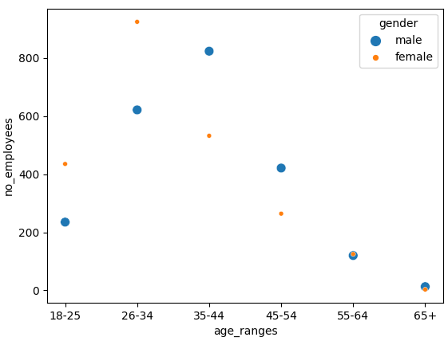
Seaborn – Relational Plots: scatterplot()
sns.scatterplot(data=data_set, x='age_ranges', y='no_employees', hue='gender', size='gender')
The 'size' parameter produces the plot in such a manner that the dependency and relationship between the multiple plots is depicted using scatter patterns of different sizes.

Slide 63
Seaborn – FacetGrid() and scatterplot()
Seaborn allows us to construct a FacetGrid object, which can be used to facet the data and construct multiple, related plots, one next to the other
import matplotlib.pyplot as plt
import pandas as pd
import seaborn as sns
# get the data set from csv file
data_set = pd.read_csv("employees.csv")
# create a facet grid grid = sns.FacetGrid(data=data_set, col='gender', hue='gender')
grid.map(sns.scatterplot, "age_ranges", "no_employees")
# save the plot into a file
plt.savefig('facet_grid.png')
Notes:
Note: hue is the data parameter around which the dependency of the passed data values are to be plotted.
The official documentation for FacetGrid() function:
https://seaborn.pydata.org/generated/seaborn.FacetGrid.html
The official documentation for FacetGrid.map() function:
http://seaborn.pydata.org/generated/seaborn.FacetGrid.map.html#seaborn.FacetGrid.map

Slide 64
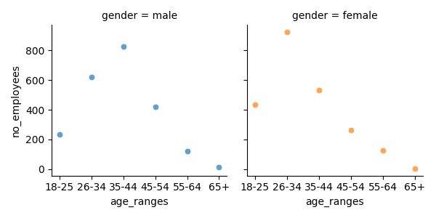
Seaborn – FacetGrid() and scatterplot()
The resulting plot is shown below
Notes:
Here, we've created a FacetGrid, passing our data (data_set) to it. By specifying the col argument as “gender", we've told Seaborn that we'd like to facet the data into genders and plot a scatter plot for each gender in the dataset.
We've also assigned the hue to depend on the gender, so each gender has a different colour.
To this grid object, we map() our arguments. We specified a sns.scatterplot as the type of plot we'd like, as well as the x and y variables we want to plot in these scatter plots.
This results in 2 different scatter plots, each with the related x and y data, separated by gender.

Slide 65
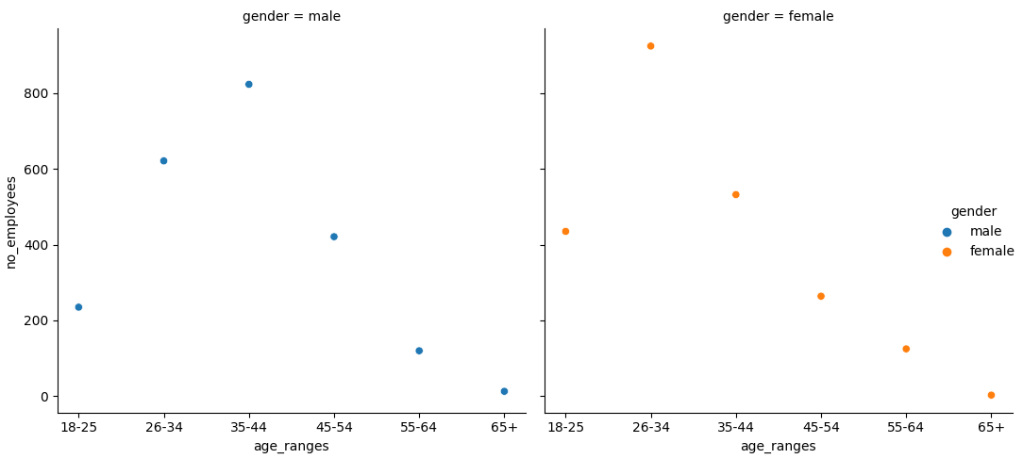
Seaborn – Relational Plots: relplot()
In general, instead of using FacetGrid() with an axes-level function, an easier and more efficient way to draw the same plot is by using the col kwarg with the relevant figure-level function - here relplot()
sns.relplot(data=data_set, x='age_ranges', y='no_employees', hue='gender',
col='gender', kind='scatter')
Notes:
Note: Using figure-level functions - here relplot(), is safer than using FacetGrid directly, as it ensures synchronization of variable order across facets.

Slide 66
Seaborn – joint plots
All of the examples so far have considered univariate distributions: distributions of a single variable, perhaps conditional on a second variable assigned to hue.
Assigning a second variable to y, however, will plot a bivariate distribution
Joint plots allow combining multiple views on the data
jointplot() is a figure-level plotting function which augments a bivariate relational or distribution plot with the marginal distributions of the two variables.
By default, jointplot() represents the bivariate distribution using scatterplot() and the marginal distributions using histplot()
Use the kind parameter to specify any of the following plots: 'scatter' | 'kde' | 'hist' | 'hex' | 'reg' | 'resid’
The following script creates a joint plot to combine a scatterplot(), showing the bivariate distribution of petal’s width and length, and a histplot(), showing marginal distributions, using the ‘iris’ seaborn built-in data set
Notes:
The official documentation for jointplot() function:
http://seaborn.pydata.org/generated/seaborn.jointplot.html
Set kind="reg" to add a linear regression fit (using regplot()) to scatter plot and univariate KDE curves to hist plot.
The official documentation for regplot() function:
http://seaborn.pydata.org/generated/seaborn.regplot.html#seaborn.regplot
Set kind="resid" to plot the residuals of a linear regression.
The official documentation for residplot() function:
https://seaborn.pydata.org/generated/seaborn.residplot.html

Slide 67
Seaborn – joint plots
import matplotlib.pyplot as plt
import pandas as pd
import seaborn as sns
# load the built-in 'iris' data set into a data frame
df_iris = sns.load_dataset("iris")
# construct the iris plot sns.jointplot(data=df_iris, x='petal_width', y='petal_length')
# save the plot into a file
plt.savefig('joint_plot.png')
The next slide shows the resulting plot
Notes:
The official documentation for jointplot() function:
http://seaborn.pydata.org/generated/seaborn.jointplot.html

Slide 68
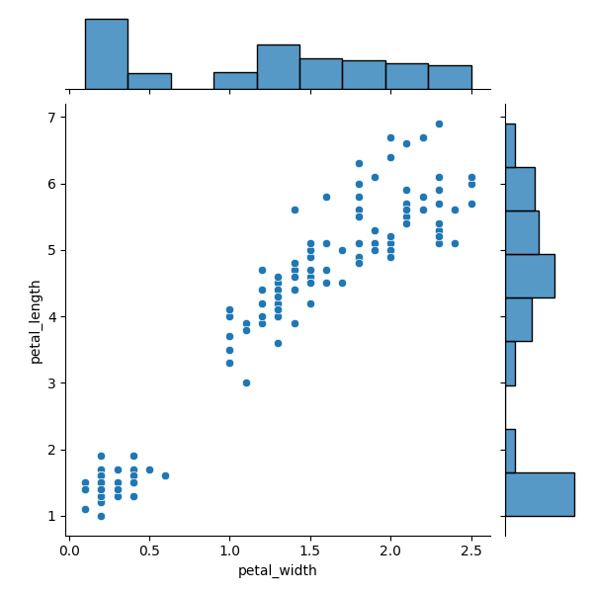
Seaborn – joint plots
The scatter plot shows the relationship between the petal lengths and petal widths: the cluster at the bottom left corner illustrates petals with short lengths and short width (probably young flowers); the relationship between lengths and widths is pretty linear: increase of petal’s lengths are followed quite proportionally with the increases of petal’s widths
The histogram on the top illustrates the distribution of petal’s widths alone
The histogram on the right illustrates the distribution of petal’s lengths alone
Notes:
The official documentation for jointplot() function:
http://seaborn.pydata.org/generated/seaborn.jointplot.html

Slide 69
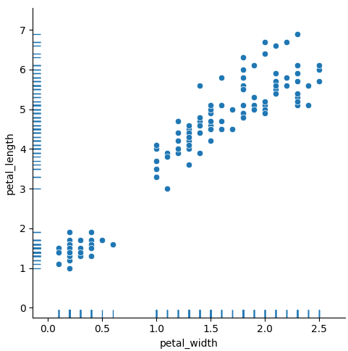
Seaborn – scatterplot() with rugplot()
sns.relplot(data=df_iris, x='petal_width', y='petal_length') sns.rugplot(data=df_iris, x='petal_width', y='petal_length')
As with jointplot(), the scatter plot shows the relationship between the petal lengths and petal widths (note that the default value for kind kwarg with relplot() is ‘scatter’)
The relational plot rugplot() can be used to add ticks (‘rugs’) along the x and y axes
The rugs on the bottom illustrate the distribution of petal’s widths alone
The rugs on the left illustrate the distribution of petal’s lengths alone
Notes:
The official documentation for rugplot() function:
https://seaborn.pydata.org/generated/seaborn.rugplot.html#seaborn.rugplot

Slide 70
Seaborn – changing plot style
Matplotlib allows you to make absolutely any type of chart.
However the chart styles of matplotlib library is not as fancy as seaborn styles.
It is possible to benefit from seaborn library style when plotting charts in matplotlib.
You just need to load the seaborn library and use seaborn set_style() function with one of the pre-set Seaborn themes: darkgrid, whitegrid, dark, white and tick.
Note: To have an effect, sns.set_style() must be called before setting the x and y labels for the plot
Notes:
Unlike Matplotlib, Seaborn comes packed with customized themes and a high-level interface for customizing and controlling the look of Matplotlib figures.

Slide 71
Seaborn – changing plot style
import matplotlib.pyplot as plt
import numpy as np
import seaborn as sns
# impact (in £k) of potential risks by % of their probability x = np.array([60, 46, 66, 48, 48, \
34, 41, 47, 45, 66])
y = np.array([456, 235, 478, 159, 248, \
490, 697, 554, 387, 454])
sns.set_style('darkgrid')
plt.xlabel('Probability %')
plt.ylabel('Impact £k')
plt.title('Risks impact and their probability')
plt.scatter(x,y)
plt.savefig('style_darkgrid.png')

Slide 72
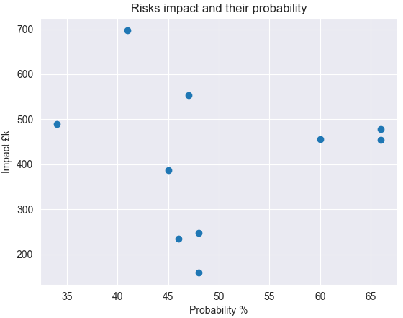
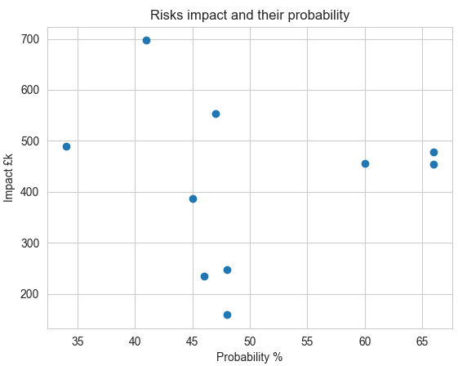
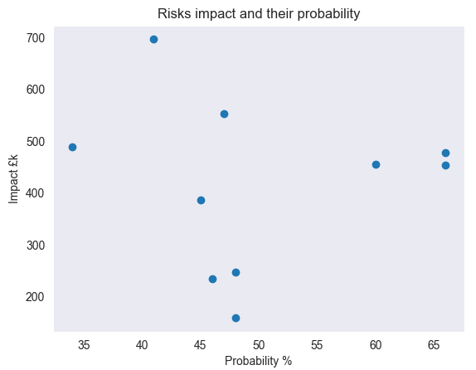
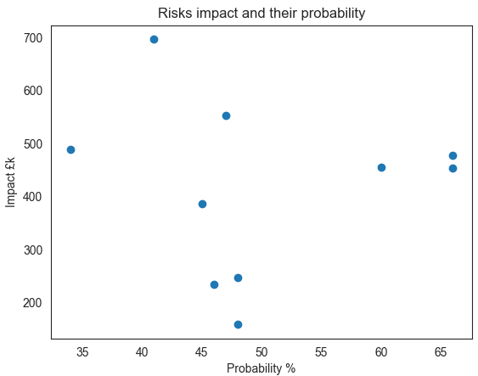
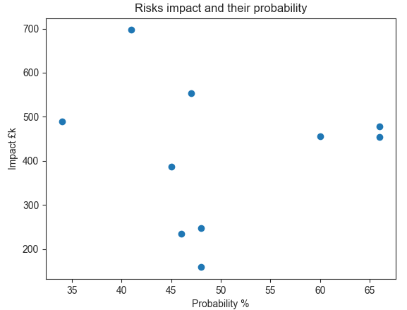
Seaborn – changing plot style
sns.set_style('darkgrid')
sns.set_style('whitegrid')
sns.set_style('dark')
sns.set_style('white')
sns.set_style('tick')

Slide 73
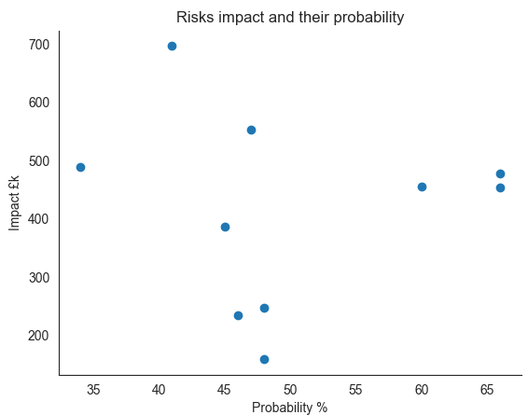
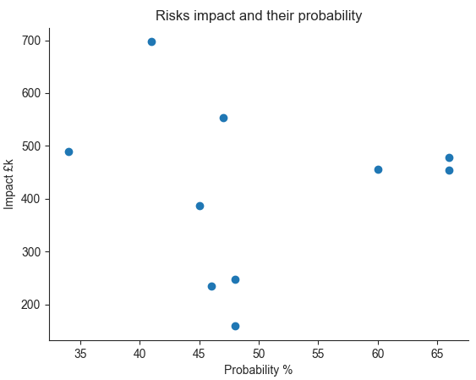
Seaborn – changing plot style
For ‘white’ and ‘tick’ styles the top and right axis spines can be removed, using the despine() function
sns.despine()
Note: To have an effect, sns.despine() must be called after setting the x and y labels for the plot

Slide 74

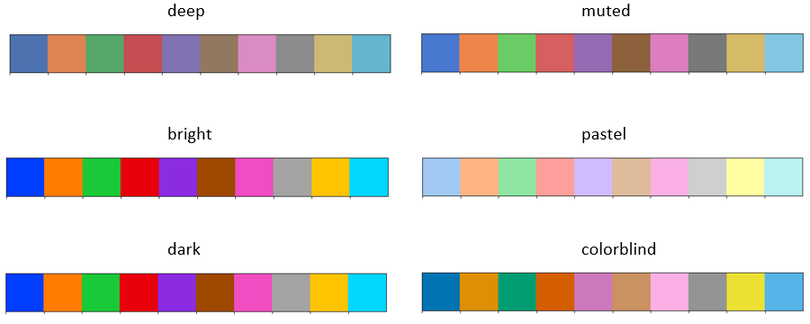
Seaborn – colours
Seaborn provides a function called color_palette(), which can be used to give colours to plots and adding more aesthetic value to it
This function can take any of the Seaborn built-in palettes
If you do not pass in a colour palette to sns.color_palette(), Seaborn will use a default set of colours:
Seaborn has six variations of its default colour palette: deep, muted, pastel, bright, dark, and colorblind:
Notes:
The official documentation for color_palette() function:
https://seaborn.pydata.org/generated/seaborn.color_palette.html

Slide 75
Seaborn – changing plot style
Check the colours of the default palette using the following script; then pass the name of each variation to the function sns.color_palette(), for example sns.color_palette('deep')
from matplotlib import pyplot as plt
import seaborn as sns
# save the default palette to a variable: palette = sns.color_palette()
# use the function sns.palplot() to plot a palette as an array of colours:
sns.palplot(palette)
plt.savefig('colours.png')

Slide 76
Seaborn – changing plot style
In addition to the default palette and its variations, Seaborn also allows the use of Color Brewer palettes
The Color Brewer palettes are useful to represent ordered categories
Check out http://colorbrewer2.org for more information about color palette configuration options
The image on the next slide shows some of the Color Brewer palettes, with their names (on the left) for easy reference and their typical use (on the right)
To use any of them just pass their name to the sns.color_palette() function, for example sns.color_palette('Accent')
Notes:
Color Brewer is the name of a set of color palettes inspired by the research of cartographer Cindy Brewer.

Slide 77
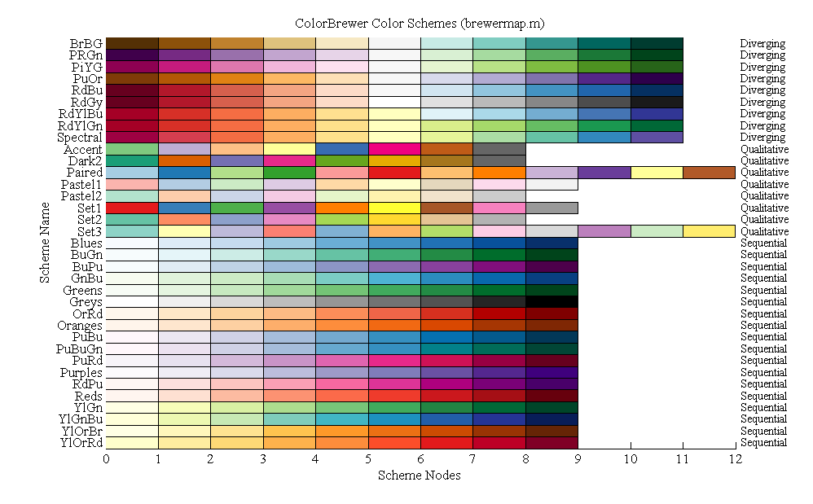
Seaborn – Color Brewer palettes
Notes:
Color Brewer is the name of a set of color palettes inspired by the research of cartographer Cindy Brewer.
The full list of color palette names (color schemes) is:
['Accent', 'Accent_r', 'Blues', 'Blues_r', 'BrBG', 'BrBG_r', 'BuGn', 'BuGn_r', 'BuPu', 'BuPu_r', 'CMRmap', 'CMRmap_r', 'Dark2', 'Dark2_r', 'GnBu', 'GnBu_r', 'Greens', 'Greens_r', 'Greys', 'Greys_r', 'OrRd', 'OrRd_r', 'Oranges', 'Oranges_r', 'PRGn', 'PRGn_r', 'Paired', 'Paired_r', 'Pastel1', 'Pastel1_r', 'Pastel2', 'Pastel2_r', 'PiYG', 'PiYG_r', 'PuBu', 'PuBuGn', 'PuBuGn_r', 'PuBu_r', 'PuOr', 'PuOr_r', 'PuRd', 'PuRd_r', 'Purples', 'Purples_r', 'RdBu', 'RdBu_r', 'RdGy', 'RdGy_r', 'RdPu', 'RdPu_r', 'RdYlBu', 'RdYlBu_r', 'RdYlGn', 'RdYlGn_r', 'Reds', 'Reds_r', 'Set1', 'Set1_r', 'Set2', 'Set2_r', 'Set3', 'Set3_r', 'Spectral', 'Spectral_r', 'Wistia', 'Wistia_r', 'YlGn', 'YlGnBu', 'YlGnBu_r', 'YlGn_r', 'YlOrBr', 'YlOrBr_r', 'YlOrRd', 'YlOrRd_r', 'afmhot', 'afmhot_r', 'autumn', 'autumn_r', 'binary', 'binary_r', 'bone', 'bone_r', 'brg', 'brg_r', 'bwr', 'bwr_r', 'cividis', 'cividis_r', 'cool', 'cool_r', 'coolwarm', 'coolwarm_r', 'copper', 'copper_r', 'crest', 'crest_r', 'cubehelix', 'cubehelix_r', 'flag', 'flag_r', 'flare', 'flare_r', 'gist_earth', 'gist_earth_r', 'gist_gray', 'gist_gray_r', 'gist_heat', 'gist_heat_r', 'gist_ncar', 'gist_ncar_r', 'gist_rainbow', 'gist_rainbow_r', 'gist_stern', 'gist_stern_r', 'gist_yarg', 'gist_yarg_r', 'gnuplot', 'gnuplot2', 'gnuplot2_r', 'gnuplot_r', 'gray', 'gray_r', 'hot', 'hot_r', 'hsv', 'hsv_r', 'icefire', 'icefire_r', 'inferno', 'inferno_r', 'jet', 'jet_r', 'magma', 'magma_r', 'mako', 'mako_r', 'nipy_spectral', 'nipy_spectral_r', 'ocean', 'ocean_r', 'pink', 'pink_r', 'plasma', 'plasma_r', 'prism', 'prism_r', 'rainbow', 'rainbow_r', 'rocket', 'rocket_r', 'seismic', 'seismic_r', 'spring', 'spring_r', 'summer', 'summer_r', 'tab10', 'tab10_r', 'tab20', 'tab20_r', 'tab20b', 'tab20b_r', 'tab20c', 'tab20c_r', 'terrain', 'terrain_r', 'turbo', 'turbo_r', 'twilight', 'twilight_r', 'twilight_shifted', 'twilight_shifted_r', 'viridis', 'viridis_r', 'vlag', 'vlag_r', 'winter', 'winter_r']

Slide 78

Seaborn – choosing the right color palette
1. Sequential palettes are a set of colours that move sequentially from a lighter to a darker colour.
Sequential palettes are suited to ordered data (e.g. numeric) that progress from low to high.
Because the darkest colours will attract the most visual attention, sequential palettes are most useful when only high values need to be emphasized.
Sequential color palettes are appropriate when a variable exists as ordered categories, such as grade in school, or as continuous values that can be put into groups, such as yearly income.
Example:
from matplotlib import pyplot as plt
import seaborn as sns
sequential_colors = sns.color_palette('BuPu', 10) sns.palplot(sequential_colors)
plt.savefig('sequential_colors.png')
Notes:
Further information:
https://seaborn.pydata.org/tutorial/color_palettes.html?highlight=color

Slide 79

Seaborn – choosing the right color palette
2. Diverging palettes put equal emphasis on mid-range critical values and extremes at both ends of the data range.
The critical class or break in the middle of the legend is emphasized with light colors and low and high extremes are emphasized with dark colors that have contrasting hues.
Diverging palettes are good for representing numeric data with a categorical boundary
Diverging palettes are best suited for datasets where both the low and high values might be of equal interest, such as hot and cold temperatures.
Example:
from matplotlib import pyplot as plt
import seaborn as sns
diverging_colors = sns.color_palette('PRGn', 10) sns.palplot(diverging_colors)
plt.savefig('diverging_colors.png')
Notes:
Further information:
https://seaborn.pydata.org/tutorial/color_palettes.html?highlight=color

Slide 80

Seaborn – choosing the right color palette
3. Qualitative palettes are sets of distinct colors which make it easy to distinguish the categories when plotted but don’t imply any particular ordering or meaning.
Qualitative schemes are best suited to representing nominal or categorical data.
An example of categorical data is car brands. Each of these values, such as BMW or Ford, are distinct from each other but there isn’t any inherent order to these categories.
Example:
from matplotlib import pyplot as plt
import seaborn as sns
qualitative_colors = sns.color_palette('Set1', 10)
sns.palplot(qualitative_colors)
plt.savefig('qualitative_colors.png')
Notes:
Further information:
https://seaborn.pydata.org/tutorial/color_palettes.html?highlight=color

Slide 81
Seaborn – plotting with palettes
By default, seaborn will use the default palette:
If the plot requires one colour, the first (blue) colour will be used
Plots requiring two colours will use the first two colours (blue and orange)
Plots requiring three colours will use the first three colours (blue, orange and green), and so on
To use a different palette, use the palette argument with a specific palette name assigned to it

Slide 82
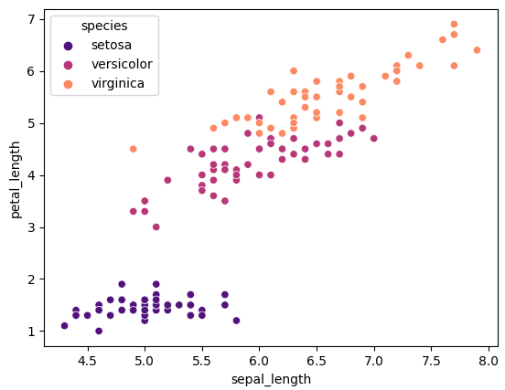
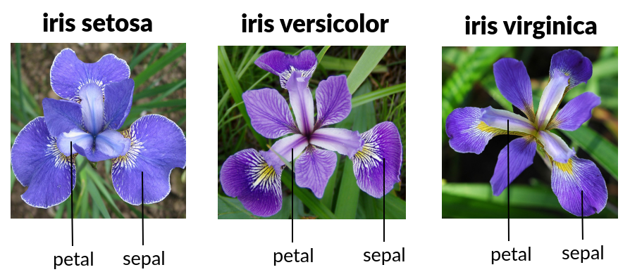
Seaborn – plotting with palettes
Example 1:
sns.scatterplot(
data=df_iris,
x="sepal_length",
y="petal_length",
hue="species",
palette="magma",
)
The species feature has 3 possible values - the "type" of the iris flowers:
setosa
versicolor
virginica
The image on the right shows the 3 iris species with the petal and sepal of each
Notes:
Remember that hue is the data parameter around which the dependency of the passed data values are to be plotted. Since hue is assigned the value “species”, hue will depend on the species, so each species of iris has a different colour.

Slide 83

Seaborn – plotting with palettes
Example 2:
sns.jointplot(
data=df_iris,
x="sepal_length",
y="petal_length",
hue="species",
palette="magma",
)
Scatter plot reveals that in all 3 iris species the lengths of petals and sepals are proportionate: the longer the petal, the longer the sepal, and that virginica has them longest, setosa has them shortest
KDE plots emphasize virginica’s greater variety of lengths: lengths of sepals 5 – 8.5, lengths of petals 4.5 – 7 compared to setosa: lengths of sepals 4 – 6, lengths of petals 1 – 2

Slide 84
Questions

Slide 85
Module Summary
Seaborn is another Python data visualization library based on Matplotlib
Matplotlib is mostly used for simple plotting and offers relatively poor default options for the size and colours of plots
Seaborn plotting functions operate on data frames and arrays that contain a whole dataset
Seaborn is used for plotting and styling of more complex plots
Histogram is the most common approach to visualizing a distribution - through the distplot() figure-level function with hist being the default value for the kind parameter: displot(data=x, kind='hist’)
Categorical data are most commonly represented with count, bar or swarm plots
Relational data are best represented with scatter plots

Slide 86
Module Summary
use the hue parameter to set the dependency column on which the passed data values are to be plotted
use the style parameter to make every value of the dependency column appear with a different shape
use the size parameter to make every value of the dependency column appear with a different size
FacetGrid() function allows constructing multiple related plots one next to the other by mapping the multi-plot grid to an axes-level function, but a simpler solution is to use the relevant figure-level function with the kind kwarg set to the axes-level function and the col kwarg set to the categorical variable to be faceted
Seaborn can make use of its own built in data sets, or load Pandas data frames
jointplot() function allows combining multiple views on the data

Slide 87
Module Summary
By default, jointplot() represents the bivariate distribution using scatterplot() and the marginal distributions using histplot(); the kind parameter can be used to change the plot type
set_style() function is used to set the plot style to one of the five seaborn pre-set themes: darkgrid, whitegrid, dark, white and tick
despine() function removes the top and right axis spines from plots
color_palette() function allows using any of the many Seaborn built-in palettes to provide specific colour sets: default, its 6 variations (deep, muted, pastel, bright, dark, and colorblind) and many other colour sets from the "Color Brewer" palettes)
use the palette parameter with a specific palette name assigned to it to apply a palette to any plot functions
palplot() function plots a palette as an array of colours

Slide 88
Module Summary
There are 3 types of palettes to use, according to specific needs:
Sequential palettes are a set of colours that move sequentially from a lighter to a darker colour - appropriate when a variable exists as ordered categories.
Diverging palettes put equal emphasis on mid-range critical values and extremes at both ends of the data range - appropriate for representing numeric data with a categorical boundary
Qualitative palettes are sets of distinct colours which make it easy to distinguish the categories when plotted but don't imply any particular ordering or meaning - appropriate for representing nominal or categorical data.

